Slide 1
5.1 living places
Year 7 Science - Biodiversity

Slide 4
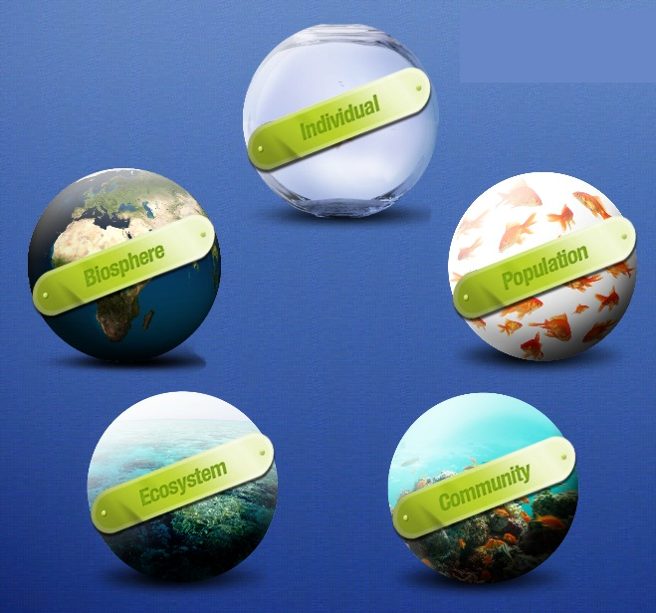

Slide 5
What is an ecosystem?
The environment is made of many different types of ecosystems, such as seashores, forests, lakes and deserts.
Each ecosystem can be divided into a:
habitat – the non-living part, (the physical area in which organisms live)
community – the living part, (all the different organisms living in that particular habitat)
Each community is made up of many different populations. A population is all the members of a particular species living in one habitat – for example, the population of kookaburras in a bushland habitat.

Slide 6
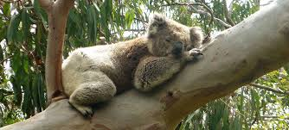
What is a habitat?
food and water
shelter and living space
suitable temperature
mating partners for reproduction
gases such as oxygen
A habitat is where an organism lives.
A habitat must provide everything
an organism needs to survive.
Notes:
Photo credit: Jupiterimages Corporation

Slide 7
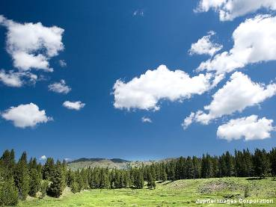
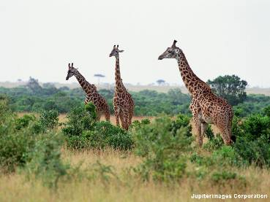
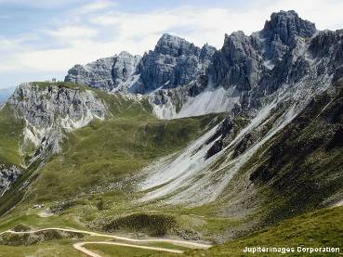
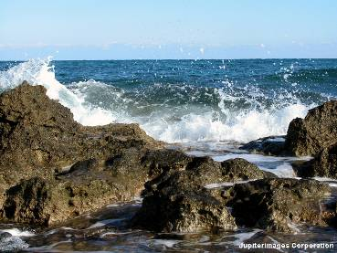
Different types of habitats
Write a list of different habitats
Wetlands
Ocean
Coral reef
Rock pool
Rainforest
Forest
Desert
Grassland
Freshwater Creek
Notes:
Photo credit: Jupiterimages Corporation

Slide 8
Biotic and abiotic factors

Slide 9
Needs of living things
Biotic Factors
Abiotic Factors
Living things within a habitat
Partners for mating
Organisms to eat (food)
Predators and competitors
Non living factors
Air (oxygen and carbon dioxide)
Light
Soil
Temperature

Slide 10
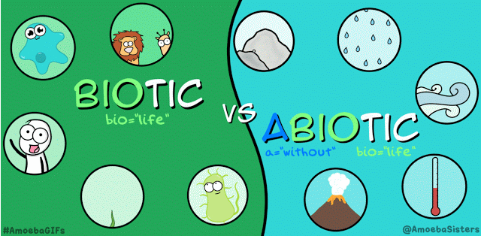
biotic vs Abiotic Factors
List the biotic and abiotic factors of the ecosystem shown on the next slide
Biotic factors | Abiotic factors

Slide 11
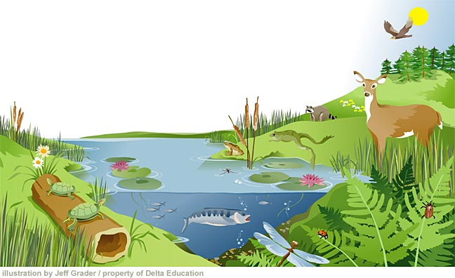
Abiotic factors
sunlight
Biotic factors
carbon dioxide
bird
trees
oxygen
temperature
deer
plants
water
frog
lily
fish
turtles
log
insects
grass
soil

Slide 12
Interactions
List at least three interactions within this habitat?
This can be between biotic and abiotic factors
Or between biotic and biotic factors
You can even have an interaction with more than one factor
Eg: Deer drinks water

Slide 13
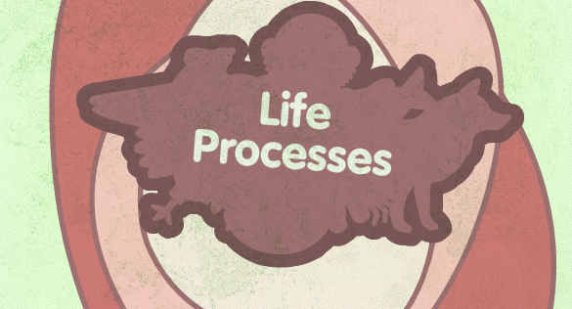
Needs of living things
Every organism has particular needs and will only live where these need are met. There are 7 life processes that can help us decide this:
Movement
Respiration (needs energy)
Sensitivity
Growth
Reproduction
Excretion (eliminate waste)
Nutrition (take in food)

Slide 14
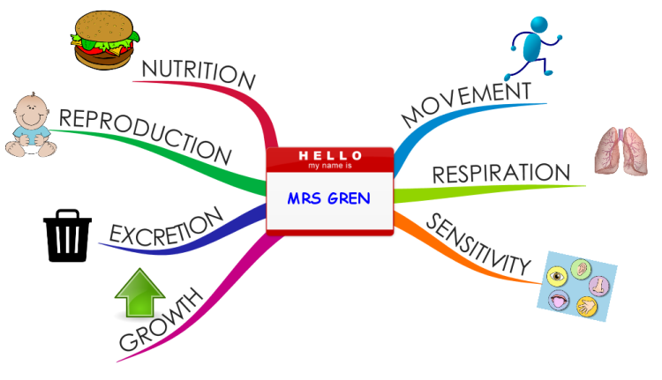
MRS GREN TASKs
Watch the life process video and answer the questions on your worksheet
Cut and Paste Activity – Match up the life processes for plants and animals

