Slide 1
r.zammit@stmonicas-epping.com
www.year7sciencewithmisszammit.weebly.com

Slide 2
Investigating Science
Year 7

Slide 3
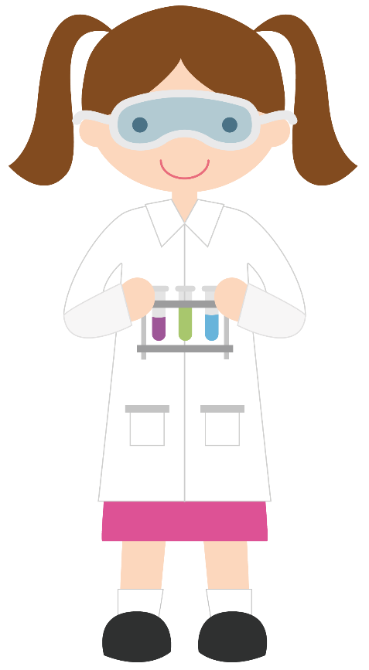
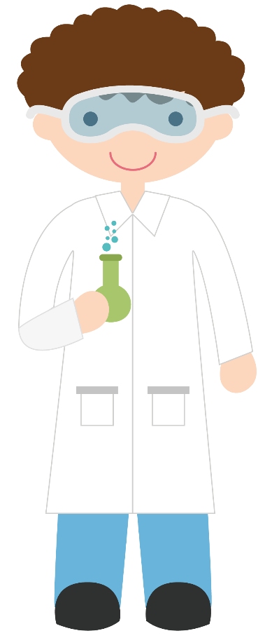
Behaviour and Expectations
Line up in a single line outside the classroom quietly before the second bell
Go to your seat quickly and quietly
No eating or drinking in the lab
Bring required things to class
Listen to others when someone is speaking
Raise your hand to ask/answer questions
Do not get out of your seat unless asked to do so
Put rubbish in the bin
Follow laboratory safety rules
At the end of the lesson, stand in silence until you are dismissed
Complete all set homework – this will be checked!

Slide 4
What to bring to Science
Charged Laptop:
Pearson e-book
IntoScience
Science exercise book
Practical book
Planner/Student Diary
Blue/Black/Red Pens
Highlighters
Glue Stick and Scissors
Ruler
Rubber
Sharpener
Grey lead pencil

Slide 5
What is Science?

Slide 6
What is Science?
Scientists study the world around them to find out how it works.
The subject of science covers many different areas.
It must be split into different branches or disciplines.
Ecology
The study of how living things interact
→ Ecosystems
→ Population Dynamics
Biology
The study of living things
→ Animals
→ Genetics
→ Botany (plants)
Physics
The study of forces and energy
→ Electricity
→ Motion
→ Machines
Psychology
Chemistry
Astronomy
The study of the universe
Planets
Stars
Sun and Moon
The study of materials and chemicals
Chemical reactions
Atoms
The study of the brain
Emotions
Mental Illness

Slide 7
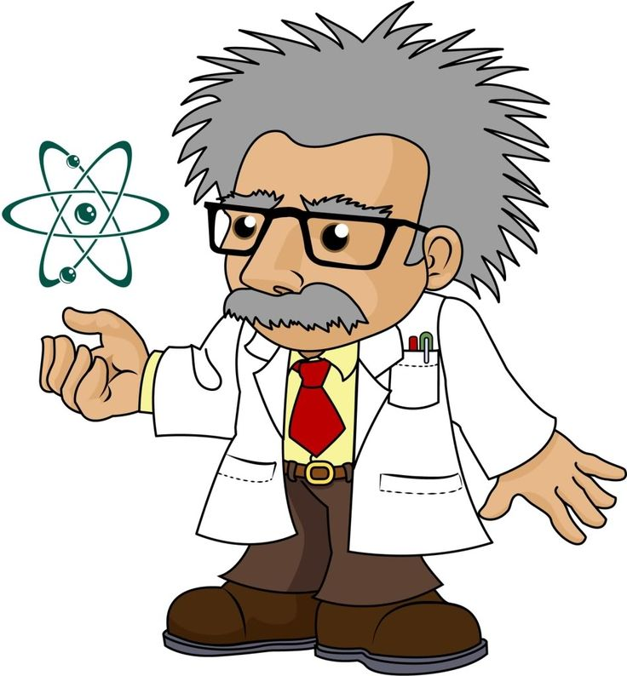
What is a scientist?
What do you think of when you hear the word scientist?
What does a scientist look like?
Not all Scientists look like this!

Slide 8
Scientists
Psychologist
Geologist
Meteorologist
Astronomer
Chemist
Physicist

Slide 9
Biologists
Marine
biologist
Taxonomist
Zoologist
Micro
biologist
Botanist
Ecologist

Slide 10
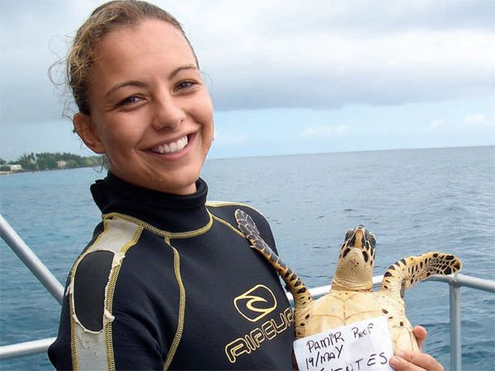
Who am I ???
I work with animals that live in the ocean
I work with living things
I work with animals
Marine Biologist

Slide 11
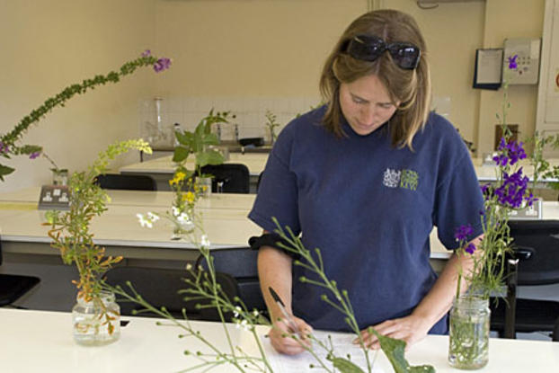
Who am I ???
I classify living things and put them into groups
I study living organisms
I look closely at their features/ characteristics
Taxonomist

Slide 12
Who am I ???
I study the behaviour of living things
I work with mostly people
I look closely at the brain
Psychologist

Slide 13
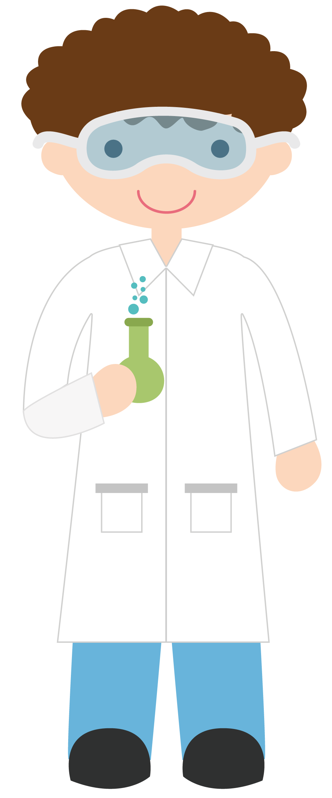
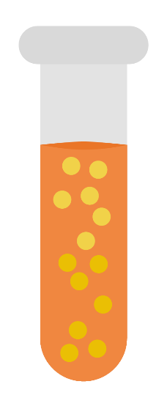
Tonight’s Homework
Decorate the first page of your workbook.
You must include – Your name
- Your class
- A heading
Write this in your planner now

