Slide 1
Relationships between organisms
Year 7 Science – Ecosystems
Chapter 5: page 188

Slide 2
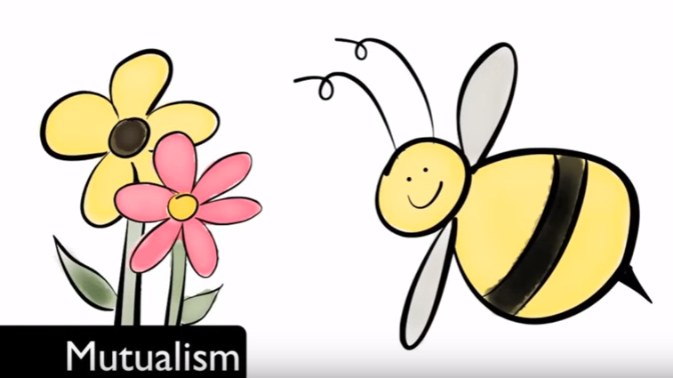
Symbiosis

Slide 3
Symbiosis
Symbiosis is defined as two different kinds of organisms that live together.
The relationship between these two organisms can be:
positive
negative
have no impact on the individuals

Slide 4
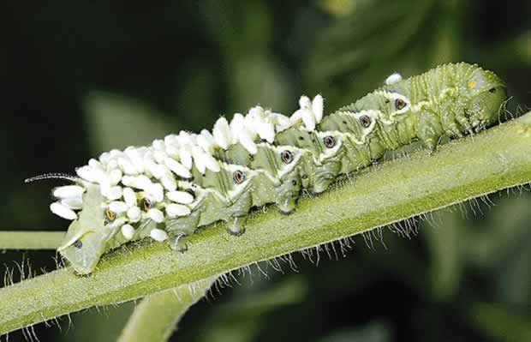
There are three types of symbiotic relationships.
They are:
Parasitism
Mutualism
Communalism
Parasitism
(+/-)
Only one organism in this relationship benefits and the other is affected

Slide 5
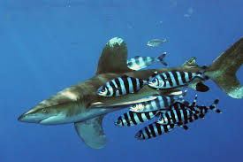
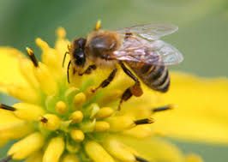
Commensalism
(+/0)
One organism in this relationship benefits and the other is not affected
Both organisms in this relationship receive benefit
Mutualism
(+/+)

Slide 6
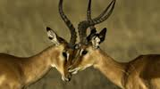
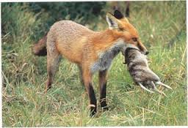
Other interactions also exist between organisms and they are:
Competition
Organisms compete with each other for -limited supplies of food, space, and mates
Predator/
Pray
Animals which consume other animals are called predators. The pray is being eaten by the predator

Slide 7
Task 1
Copy the table on the next two slides into your work book
“How does each benefit” draw a + - or 0 next to each organism
+ means the organism is gaining a benefit from the relationship
- means the organism is being harmed by this relationship
0 means the organism is not receiving harm or benefiting from the relationship
In the last column, list which type of symbiotic relationship this is:
Commensalism
Mutualism
Parasitism
Answer Q11 and 12 review questions on page 190

Slide 8
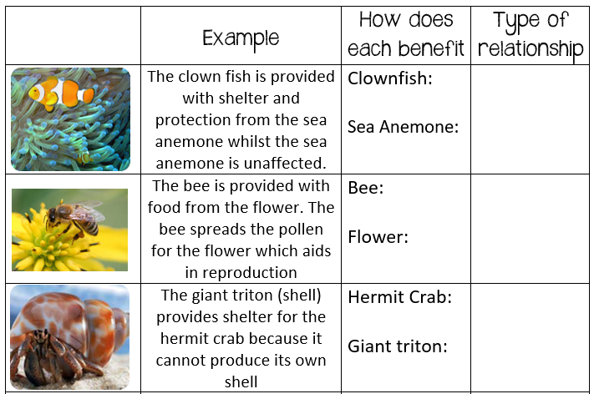
Symbiotic Relationships

Slide 9
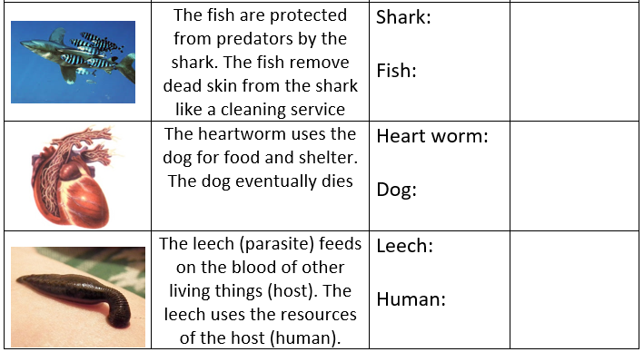
Symbiotic Relationships

Slide 10
Task 2
Use the following website to identify different relationships in an ocean ecosystem
http://www.pbs.org/wgbh/evolution/survival/coral/index.html
Find the relationships shown on the next 5 slides and write the following for each into your workbook:
List the type of relationship
Identify how it effects each species involved
Explain how the relationship works

Slide 11
Click on these boxes which will take you to different parts of the ocean
Click on each type of relationship which will
show you the interaction between organisms.
Yellow is predation OR parasitism
Green is competition
Orange is commensalism OR mutualism
This information will help you answer your questions:
List the type of relationship
Identify how it effects each species involved
Explain how the relationship works

Slide 12
Predation
Crown of Thorns Starfish (+) and Hard Coral (-)
Starfish pray on hard coral. As the starfish don’t have many predators, their populations grow hence the hard coral cannot recover and die

