Slide 1
Safety Rules

Slide 2
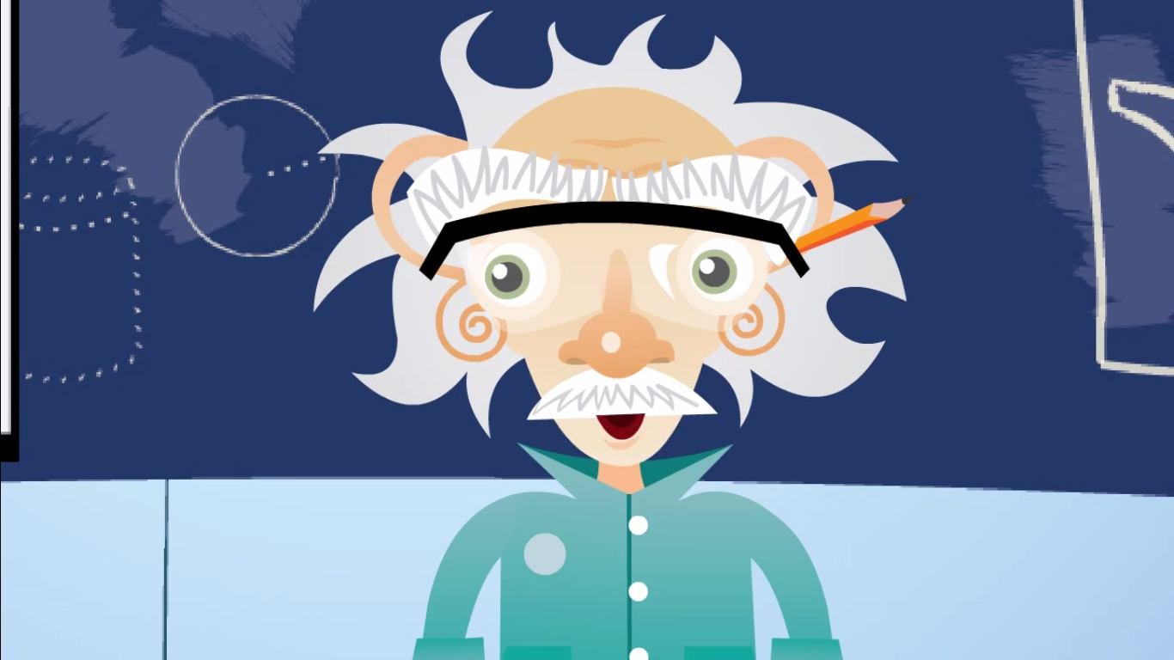
Introduction to Lab Safety
https://www.youtube.com/watch?v=tsAHt0FiwNM

Slide 3
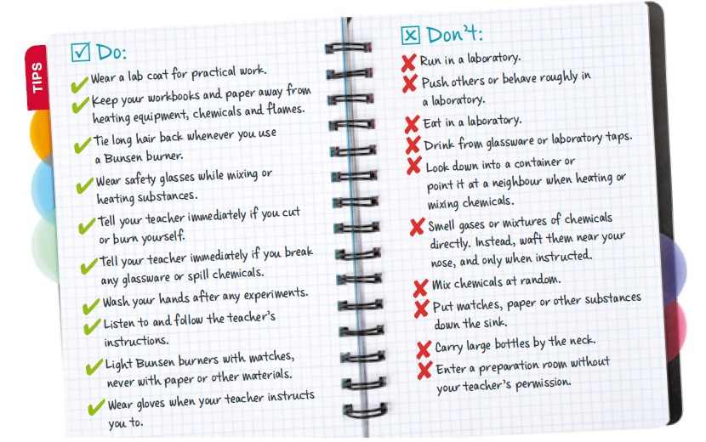
Laboratory Safety Rules

Slide 4
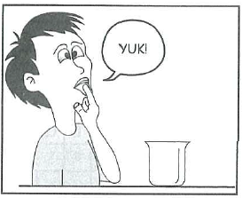
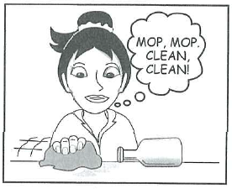
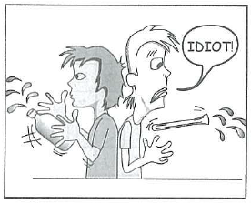
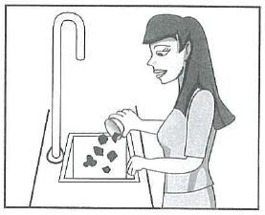
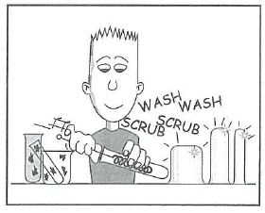
Activity: Laboratory Safety Rules
Do not taste the chemicals
Clean up spills ASAP
Watch where you are going
Do not pour solids down the sink
Wash equipment
after use

Slide 5
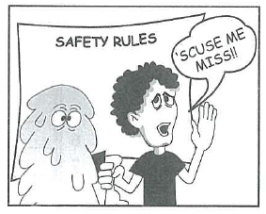
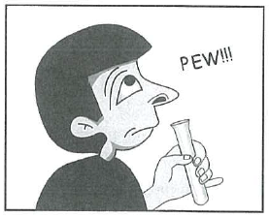
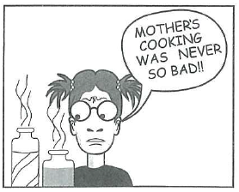
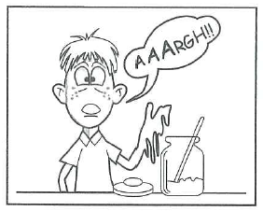
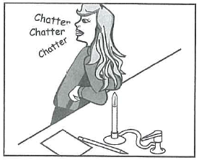
Activity: Laboratory Safety Rules
If something goes wrong, tell your teacher
Do not smell the chemicals
Do not eat the chemicals
Never touch chemicals
Tie long hair back and PAY ATTENTION

Slide 6
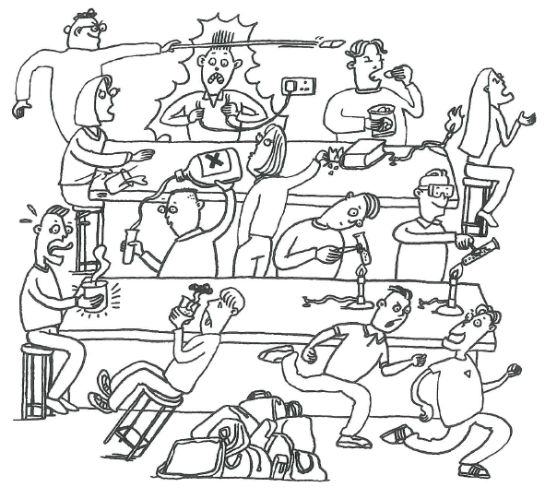
Activity: Laboratory Safety Rules

Slide 7
Activity: Into Science
Log in to Into Science --> Activities --> Science-A journey of discovery --> Lab rules and safety precautions

Slide 8
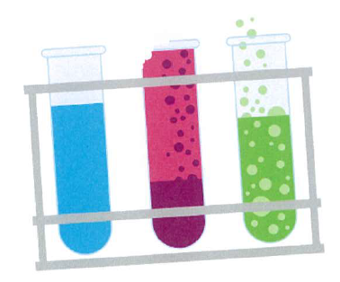
Safety Poster Assessment Task
Design a poster for your science classroom. The poster should warn visitors about one of the dangers that could happen in the science laboratory or illustrate one safety rule that should be remembered.
Your poster should:
Be clear
Have a simple message so it is easy to read
Have large writing and pictures so it can be seen
from a distance
Be colorful to attract attention
Have a border

Slide 9
Safety Poster Assessment Task
In class
1. Make a rough draft or plan (in your exercise book) of your poster.
2. Show the plan to your teacher.
At home
3. Make your poster.
4. Use the assessment sheet as a checklist.
Submit this separately from your poster.
Due date is:
Write this into your planner

