Slide 1
Adaptations
5.1 Living Places

Slide 2
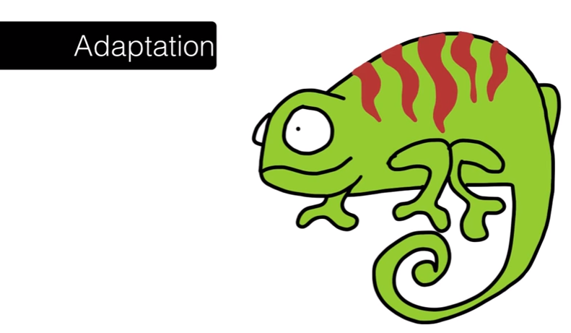
Adaptations

Slide 3
Adaptations
Adaptations
To survive in their habitat, organisms have adaptations.
Adaptations are characteristics that assist organisms to survive and reproduce.
Adaptations enable animals to:
protect themselves from predators
(camouflage)
survive hot and cold temperatures
survive wet and dry seasons
move from place to place (flippers, legs, wings)
catch and eat food
take in oxygen
reproduce

Slide 4
How do animals adapt to arid/dry conditions
long eye lashes, hairy ears and closing nostrils help to keep out sand
thick eyebrows which stand out and shade eyes from the sun
wide feet so they don’t sink in the sand
they can go without water for over a week because they can drink gallons in one go
they can go months without food – they store fat in their humps
body temperature can change to avoid losing water through sweating
they are well camouflaged
thick fur helps to keep them warm at night

Slide 5
Adaptations
Adaptations
Adaptations enable plants to:
protect themselves from grazing animals (spines and thorns)
capture light (large leaves)
take in water (very long roots)
take in oxygen and carbon dioxide
reproduce

Slide 6
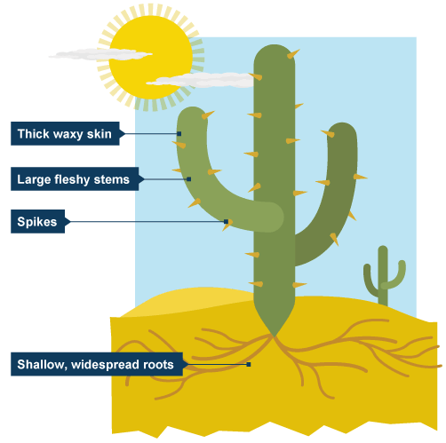
How do plants adapt to arid/dry conditions
thick, waxy skin to reduce loss of water and to reflect heat
large, fleshy stems to store water
thorns and thin, spiky or glossy leaves to reduce water loss
spikes protect cacti from animals wishing to use stored water
deep roots to tap groundwater
long shallow roots which spread over a wide area
plants lie dormant for years until rain falls

Slide 7
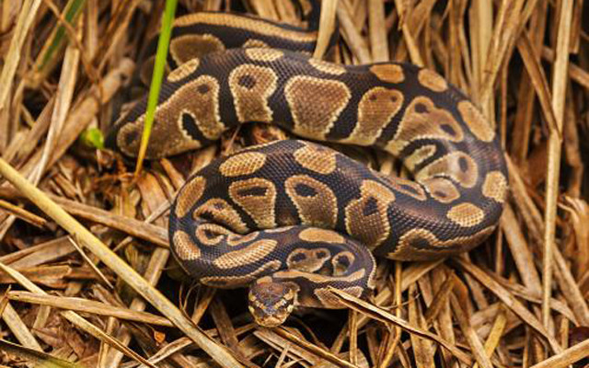
Structural Adaptations
A physical feature/characteristic that an organism has that helps it survive in its environment
The way an organism’s body part are built to help it survive.
Examples:
Small ears on an arctic fox
Kangaroo pouch
Colour to camouflage
Sticky pads on gecko feet
Spines on cactus plant
Wings for flight
Body coverings, spikes on echidna
Arctic foxes have thicker fur for surviving the freezing temperatures;
Camels have long eyelashes and the ability to close their nostrils to keep sand out.

Slide 8
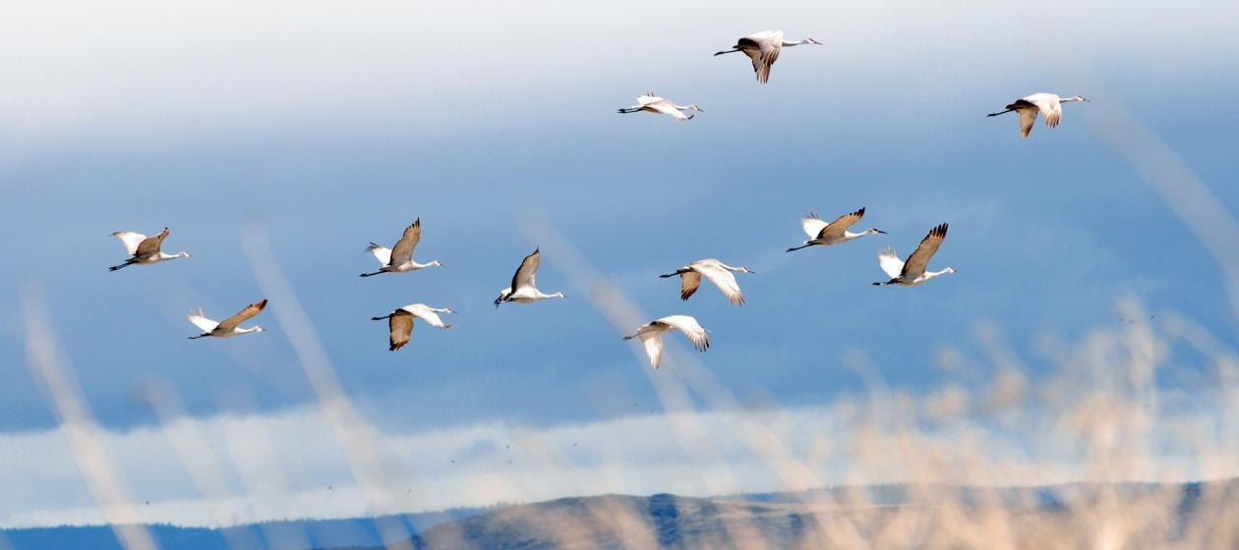
Behavioural Adaptations
Something a species does/behaves in order to survive in its natural environment
The way the organism acts to help it to survive.
Behavioural adaptations can be instinctive or they can be learned. Instinctive behaviour is a behaviour pattern that the organism naturally follows.
Examples:
Breeding times
Mating calls
Nesting
Migration
Hibernation
Hunts at night

Slide 9
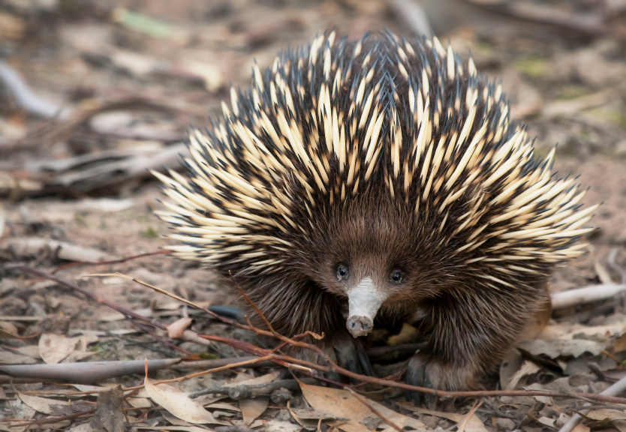
Functional Adaptations
Functional adaptations refer to the working of an organism's body involving internal body systems.
These adaptations relate to the general functioning of the body.
The way an organism’s body works to help it survive.
Examples:
Bilby sense of smell
Echidna produces sticky saliva
Little urine to save water
Keep a constant temperature
Make venom or slime

Slide 10
Adaptations of the emperor penguin

Slide 11
Adaptations of the artic fox

Slide 12
Adaptations of the barn owl

Slide 13
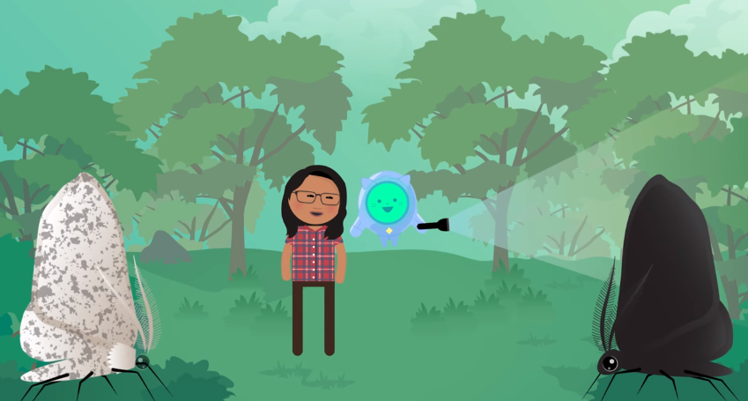
Summary and Case Study: Peppered Moth

Slide 14
Your task
Complete cut and paste activity
Identify the adaptations as structural, behavioural or functional
Answer 5.1 review questions on page 190: Q4, 14, 15

