Slide 1
Lab Equipment

Slide 2
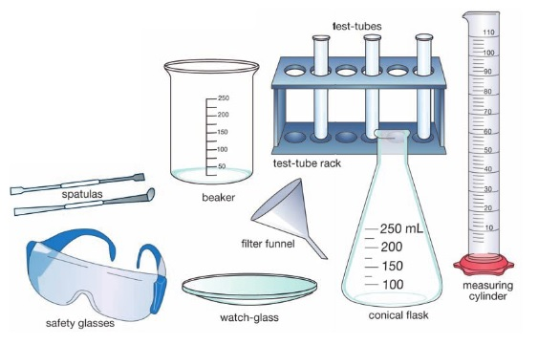
Lab Equipment
Glassware
Glassware such as beakers, conical flasks, test-tubes and
watch-glasses allows you to mix and heat chemicals
Beakers and conical flasks usually have markings
up their sides, but the markings only indicate rough volumes.
Always use a measuring cylinder to measure accurate volumes usually in mL

Slide 3
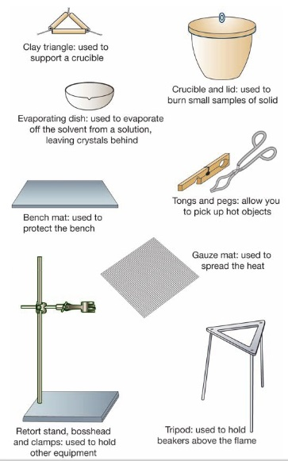
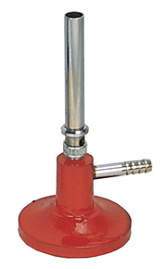
Lab Equipment
Heating Objects
The Bunsen Burner is used to heat things in the lab.
You will learn about the Bunsen Burner in a lot more
detail next week
A Bunsen burner also needs additional equipment to help you heat objects and
to keep you safe.
Bunsen Burner

Slide 4
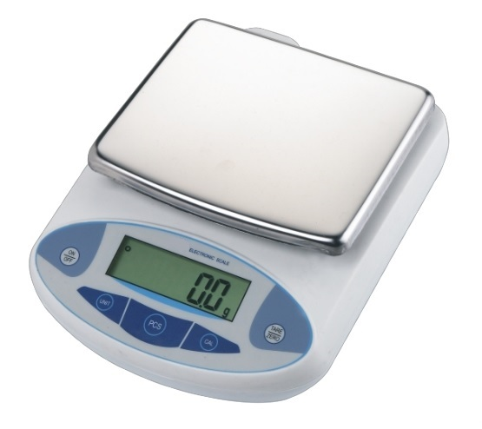
Lab Equipment
Electronic Balance
Used to measure the mass of an object in grams.
Mass is a measure of how much matter there is in an object.
Usually measured in grams (g)

Slide 5
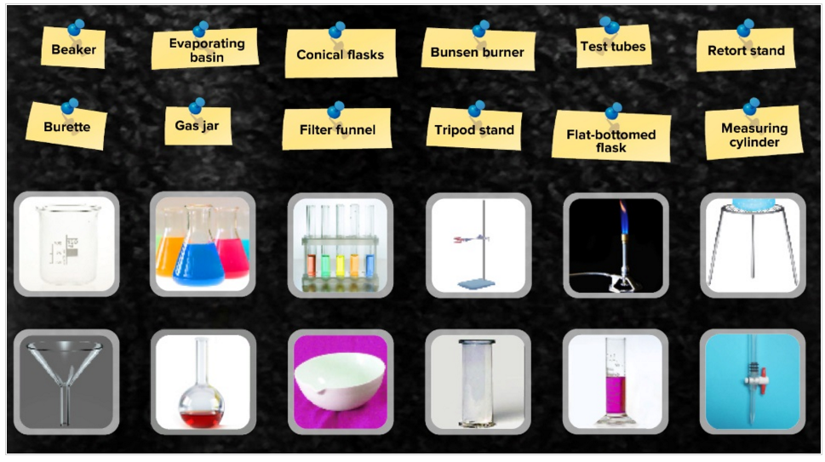
Activity: Into Science
Log in to Into Science --> Activities --> Science-A journey of discovery --> Equipment and apparatus

Slide 6
ACTIVITY: Which piece of equipment?
Using your Pearson ebook
(pages 6-7), you are to complete the cut and paste activity matching the equipment to their uses.
Show your teacher before you stick them into your book

Slide 7
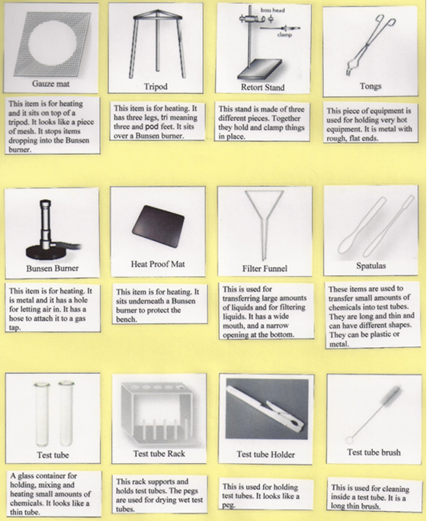
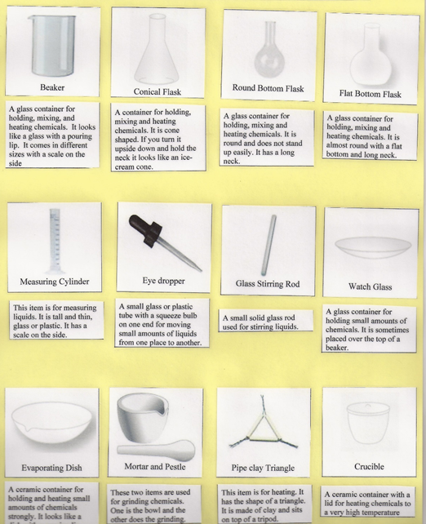

Slide 8
Module 1.1
Questions
Q3,5,6,7,11,12,14,20
(page 20)

