Slide 1
Food Chains and Food Webs
Module 5.2

Slide 2
Can you see a food chain in this habitat

Slide 3
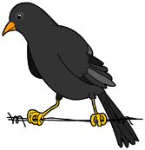
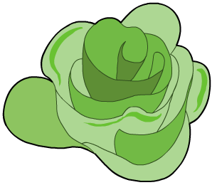
Food Chains
A food chain is a sequence that shows how each individual feeds on the organism below it in the chain.
leaf
caterpillar
bird
fox
What does this food chain show?
A leaf is eaten by a caterpillar, which is then eaten by a bird, which is then eaten by a fox. The arrow always points to the mouth.
Energy is transferred from one organism to another in the direction of the arrow.

Slide 4
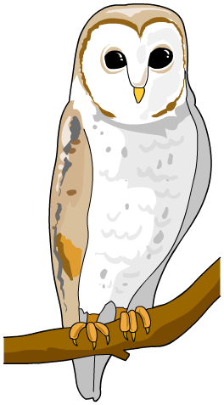
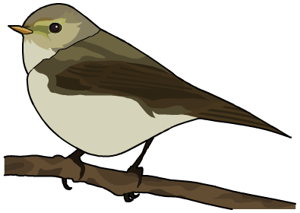
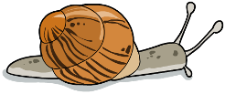
Producers
All food chains always start with a producer
If the producer is a plant, only a small part of it might be
involved in the food chain, such as its seeds, fruits, leaves or even dead leaves.
But how do plants produce their food or energy?
leaf
snail
bird
owl

Slide 5
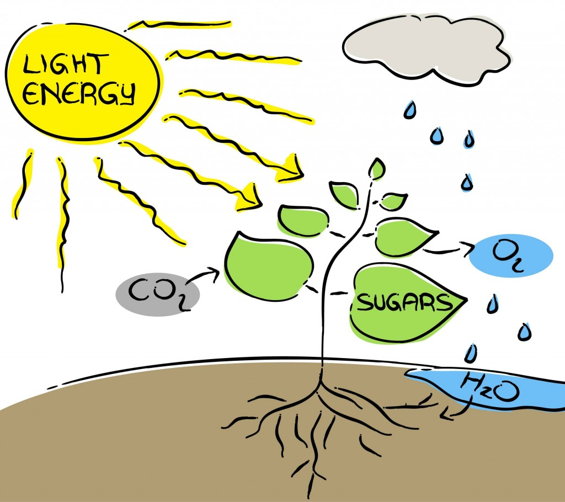
Photosynthesis
Photosynthesis is the process in which plants can make their own food (hence they are called autotrophs)
Plants use energy from the sun to combine the carbon dioxide and water to form glucose (sugar) and oxygen
Carbon dioxide
Glucose
Oxygen
Water
LIGHT

Slide 6
Photosynthesis

Slide 7
Food Chains
Identify any mistakes in the following food chains:
Chain 1 This chain is missing a producer
Snail →bird
Chain 2 This chain is correct
Lettuce→ caterpillar → magpie
Chain 3 The arrow is the wrong way
Human → apple

Slide 8
An Antarctic food chain

Slide 9
Draw the following food chains into your workbook

Slide 10
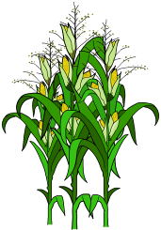
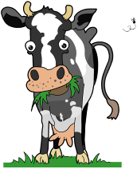
Feeding types
Different types of organism can be grouped in several ways. One grouping system is based on how organisms obtain their food.
Some organisms produce their own food. We already know that they are called producers.
Plants produce their own food using light energy from the Sun. Some types of bacteria can also make their own food by using light or chemical reactions.
Other organisms cannot make their own food.
They are called consumers
They have to eat in order to get their energy.
Also known as heterotrophs

Slide 11
Producer or Consumer

Slide 12
Draw the following table in your book
Producer | Consumer | Decomposer

Slide 13
Producer or Consumer

Slide 14
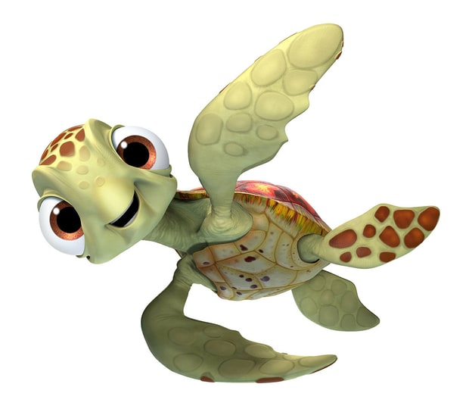
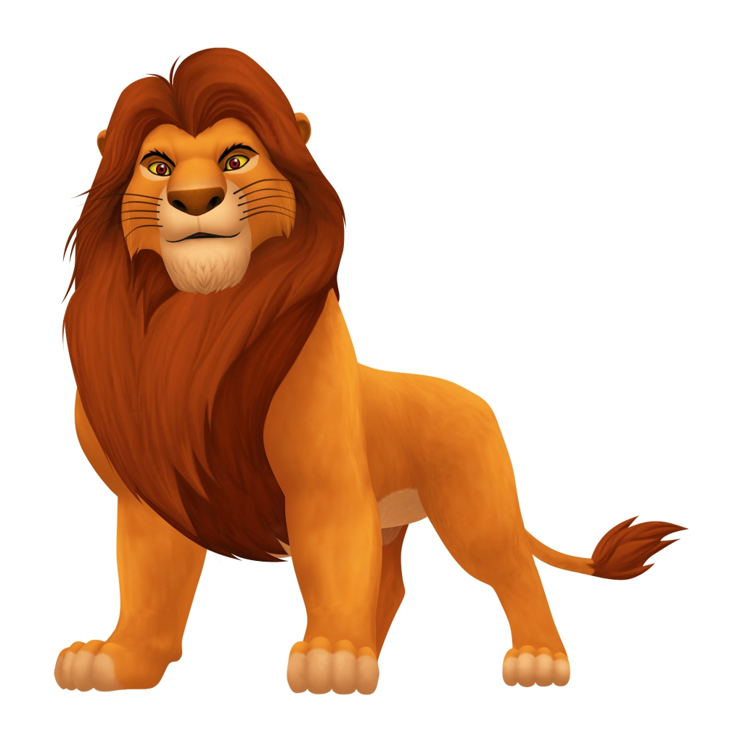
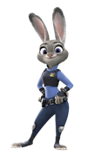
Consumers
Consumers can be grouped into different types:
Herbivore | Carnivore | Omnivore
Eats both plants and animals | Eats other animals | Eats plants

Slide 15
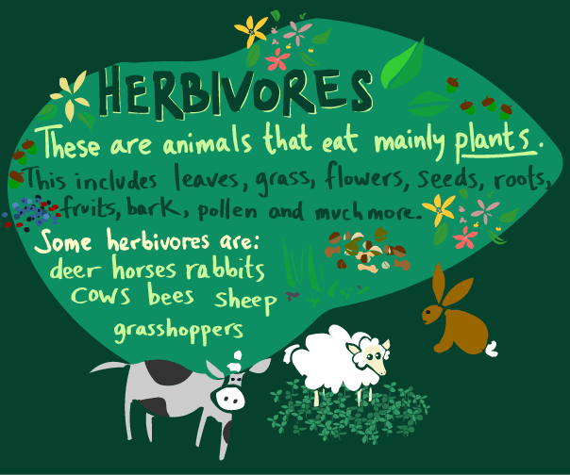

Slide 16
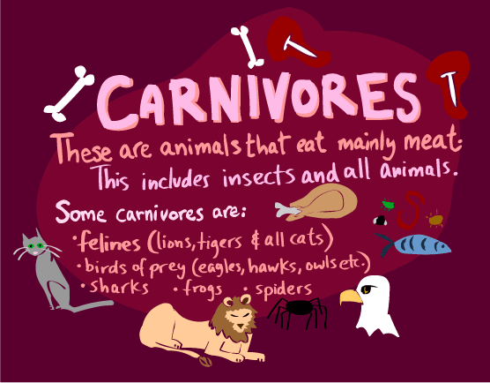

Slide 17
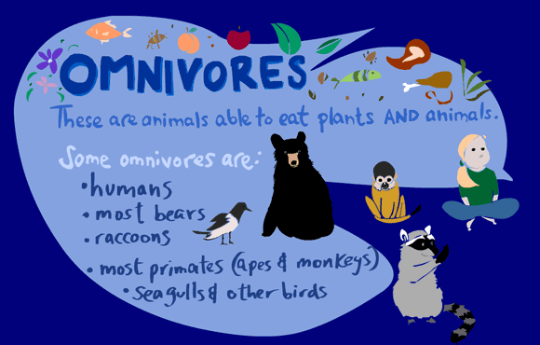

Slide 18
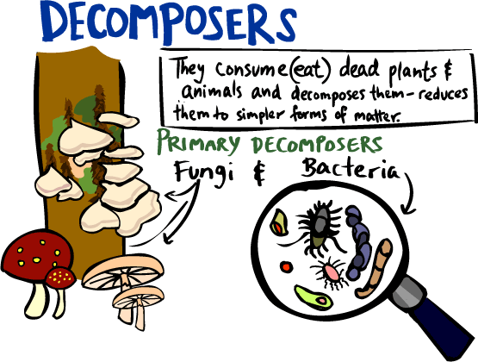

Slide 19
Decomposers

Slide 20
Feeding Types

Slide 21
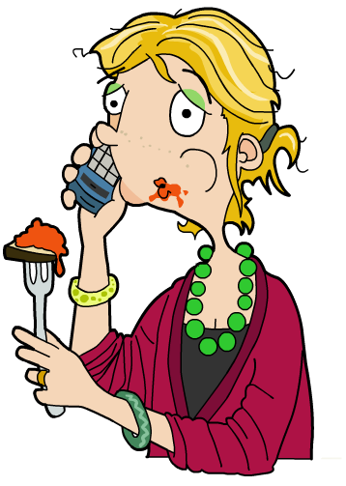
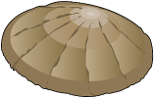
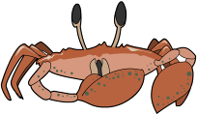
Ranking Consumers
Consumers eat plants or animals, or both.
A food chain can be used to rank different types of consumers.
seaweed
limpet
crab
human
producer
primary
consumer
secondary
consumer
tertiary
consumer
Producers – make their own food.
Primary consumers – eat producers.
Secondary consumers – eat primary consumers.
Tertiary consumers – eat secondary consumers.

Slide 22
Primary, Secondary or Tertiary

Slide 23
Food chains
Here's another food chain, with a few more animals.
It starts with acorns, which are eaten by mice. The mice are eaten by snakes, and then finally the snakes are eaten by hawks. At each link in the chain, energy is being transferred from one animal to another.
There can be even more links to any food chain. Here another animal is added. Grass to grasshopper to mouse to snake to hawk.

Slide 24
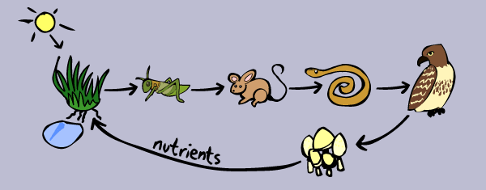
Food chains
There is actually even more to this chain.
After a hawk dies, fungi (like mushrooms) and other decomposers break down the dead hawk, and turn the remains of the hawk into nutrients, which are released into the soil.
The nutrients (plus sun and water) then cause the grass to grow. It's a full circle of life and energy!!

Slide 25
Food chains
So food chains make a full circle, and energy is passed from plant to animal to animal to decomposer and back to plant! There can be many links in food chains but not TOO many. If there are too many links, then the animal at the end would not get enough energy.

Slide 26
What do consumers eat?
Can you think of a consumer that eats only one kind of food?
Do most consumers eat only one kind of food?
If consumers can eat more than one kind of food, how can we show this with a diagram?

Slide 27
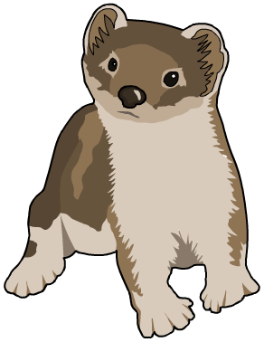
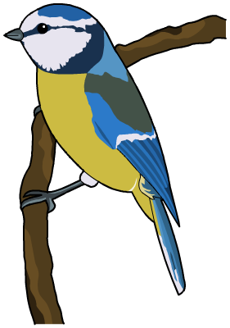
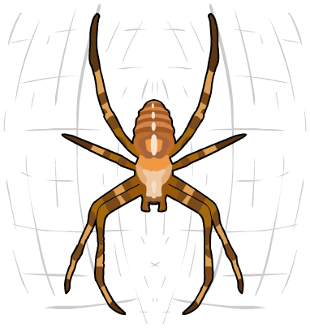
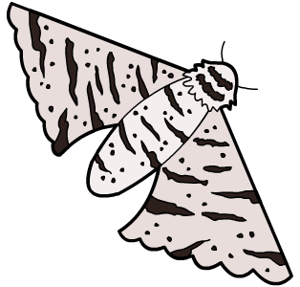
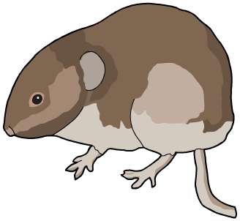
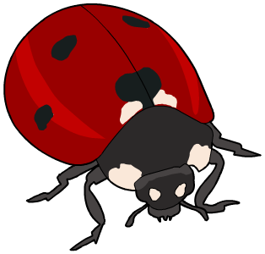
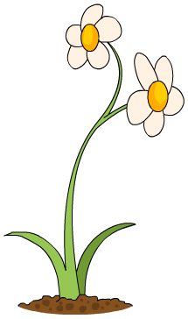
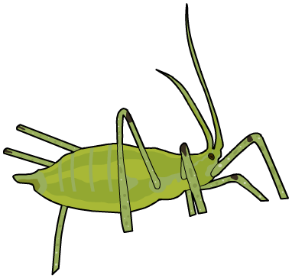
Food webs
sparrow
owl
stoat
bluebird
moth
spider
vole
ladybird
aphid
plant

Slide 28
1. Name the producer in this food web.
Using a food web
2. Name two herbivores in this food web.
3. Name two species that are top carnivores.
4. How many secondary consumers are there?
5. Which food chains include the moth?
Notes:
Teacher notes
1. Daisy (flower/plant)
2. Vole and aphid (moth is also an acceptable answer – adult moths usually don’t eat, but their larvae do)
3. Stoat and barn owl
4. Four (ladybird, spider, stoat, blue tit)
5. Daisy, moth, blue tit, barn owl. Daisy, moth, spider, goldfinch, barn owl.

Slide 29
Build a food web

Slide 30
Food Web Cut and Paste Activity
Construct food web on A3 paper
Ensure arrows are pointing in the right direction
Label each organism as producer/first order/ second order/ third order consumer
Label all consumers as a herbivore/carnivore/omnivore
Make 5 food chains from your food web

Slide 31
Changes in food webs
Some animals are very sensitive to change
Animals can become extinct due to changes
This will effect the entire food web
Animals can be directly or indirectly effected
Eg: Change in temperature (coral)
Eg: Hunting (rabbits)
Eg: Disease

Slide 32
Food webs
chiffchaff
owl
stoat
bluebird
moth
spider
vole
ladybird
aphid
plant

Slide 33
Food webs
What would happen to this food web if the moth was removed???
Everything will be affected!
There will be more plants → only the aphid will eat the plants
The Spider will not have a food source and die (direct impact)
The Chiffchaff will not have a food source (spider) and die (indirect impact)
The Bluebird will have less food therefore more competition for ladybirds (ladybird population will decrease)
The Owl will have less food also
chiffchaff
owl
bluebird
moth
spider
ladybird
aphid
plant

Slide 34
Activity
On your A3 food web answer the following questions
Propose what would happen to the vole population if the grasshoppers disappeared from the area
Propose what would happen to the frog and snake populations
Explain any other animals which will be affected if the grasshopper population disappears

