Slide 1
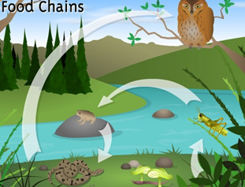
Food Chains
Year 7 Science:
Habitats and Interactions

Slide 2
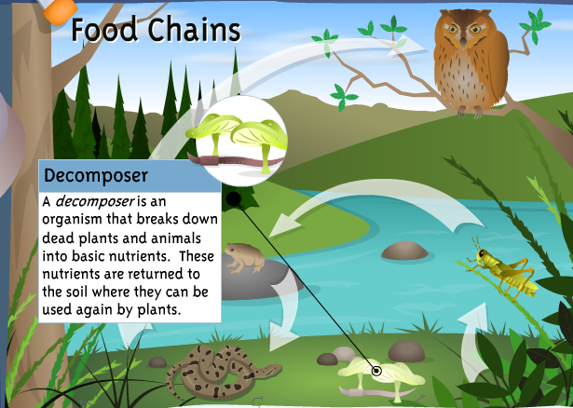
Learning about food chains
1. Go to the following website:
http://www.iknowthat.com/ScienceIllustrations/foodchains/science_desk.swf
2. Click on each part of
the interactive to write the
definitions on the next slide
(see image).
3. Write a food chain for each
of the 4 different habitats, and
list the producer, primary,
secondary and territory
consumer for each

Slide 3
 | Write a definition and give an example
Producer
Primary Consumer
Secondary Consumer
Tertiary Consumer
Decomposer
Omnivore
Carnivore
Herbivore

Slide 4
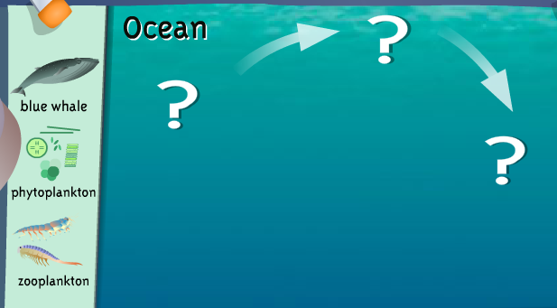
For each habitat, write a food chain and list the producer, primary, secondary and tertiary consumers

Slide 5
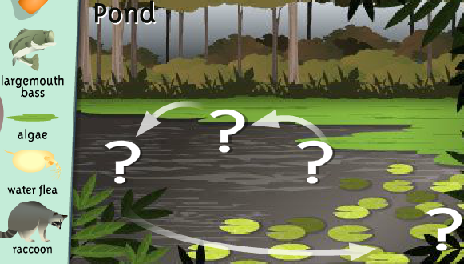
For each habitat, write a food chain and list the producer, primary, secondary and tertiary consumers

Slide 6
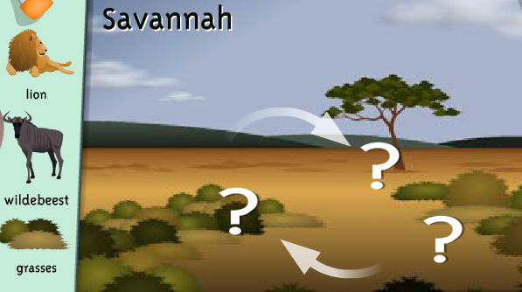
For each habitat, write a food chain and
list the primary, secondary and tertiary consumers

Slide 7
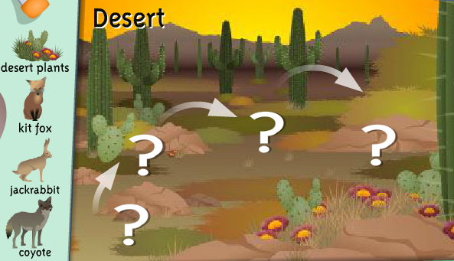
For each habitat, write a food chain and
list the primary, secondary and tertiary consumers

