Slide 1
Classification of Animals
Kingdom
Phylum
Class
Order
Family
Genus
Species
Chapter 6.3 page 217

Slide 2
Key Terms
Endothermic
Ectothermic
Animals that can generate their own heat and are able to control their
body temperature
Animals whose regulation of body temperature depends on external sources, such as sunlight or a heated rock surface. (cold-blooded)
Endoskeleton
Exoskeleton
A skeleton inside the body
A skeleton on the outside
of the body

Slide 3
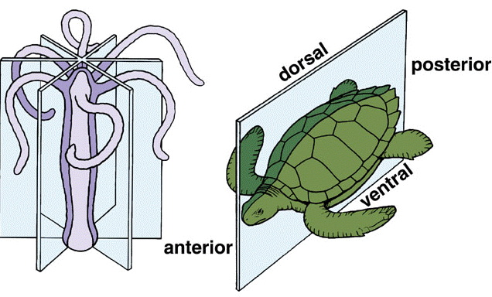
radial symmetry
Body parts are arranged around a central axis –
cut in any direction will result in two identical halves
bilateral symmetry
Only one way to cut into two equal parts

Slide 4
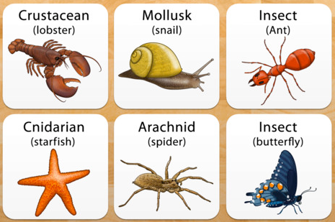
Invertebrates
Poriferans
Cnidarians
Echinoderms
Annelids
Nematodes
Platyhelminths
Molluscs
Arthropods
Animal's that don’t have a back bone

Slide 5
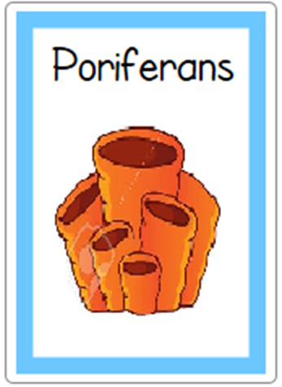
Poriferans live in the water and most are found in marine environments.
They are commonly called sponges because they are full of holes (pores) through which water passes, carrying their food.
They filter the food out of the water, and for this reason they are known as filter feeders.
The wastes along with water are pushed out through an opening at the top of the sponge.

Slide 6
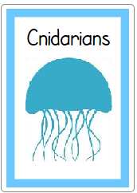
Cnidarians have radial symmetry.
Jellyfish, sea anemones and coral polyps belong to this phylum.
They have only one body opening.
Food goes into the body through this opening and waste comes out of the same opening.
Cnidarians all have stinging cells, which they use to catch their food.

Slide 7
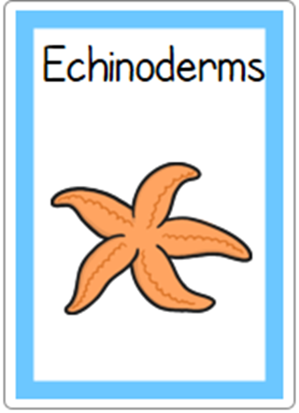
Echinoderms also live in the ocean, often near the coast.
Starfish, brittlestars, sea urchins and sea cucumbers belong to this phylum.
Starfish, brittlestars and sea urchins have a spiny skin
The skin of sea cucumbers is leathery.
One thing common to all Echinoderms is that they have radial symmetry.

Slide 8
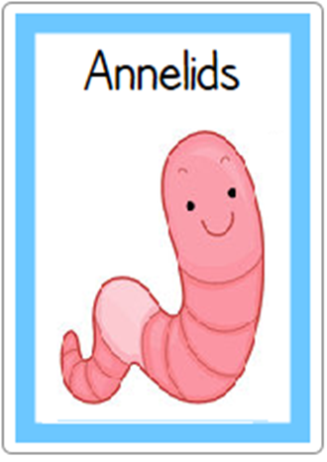
Annelids are found in water and in damp places on land.
The most familiar annelid is the earthworm. Others include leeches and ragworms (often used as bait for fishing).
Annelids have rings along the length of its body. These rings are segments or divisions within the body, and give the group their common name of ‘segmented worms’.
These animals have bilateral symmetry.

Slide 9
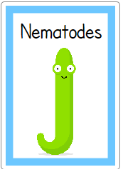
Nematodes are also called worms, but they do not have segments. They are ‘round worms’
They have bilateral symmetry like annelids, with long tapered bodies that are pointed at each end.
They are commonly found in damp soil, in water, and as parasites in the bodies of other organisms.
Heart worm, a common disease of dogs, is caused by a nematode. Even humans can be hosts to parasitic nematodes.
Parasites are organisms that live on or in another organism, called a host. They get their food from the host, but the host gets nothing in return and may be harmed.

Slide 10
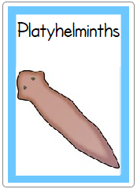
Platyhelminths also have worm as part of their
common name—they are flat worms.
They have bilateral symmetry with the body flattened top to bottom
They live in water or very moist places
There are over 12 000 species of platyhelminths.
Some are scavengers, cleaning up the wastes in the oceans and waterways, some eat microscopic animals, but many are parasites.

Slide 11
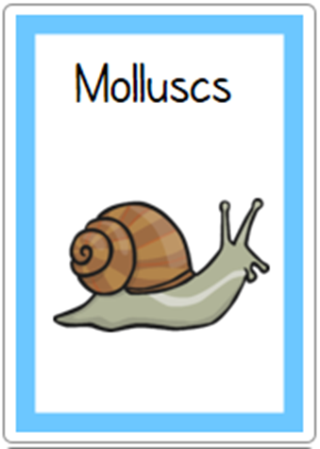
Molluscs are members of the second largest phylum in the animal kingdom.
All of them live in water or in very moist places.
Snails, slugs and oysters belong to this group.
They come in a wide variety of shapes and sizes, but all have bilateral symmetry,
have well developed internal organs,
and have a muscular foot which they can use to move along.
Some molluscs have a shell for protection.

Slide 12
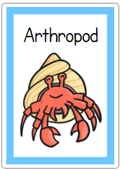
Arthropods are found everywhere—on land, in the air and in water.
They are the largest animal phylum, with over one million species described.
Arthropods are able to survive on dry land because they have a waterproof exoskeleton
The skeleton does not bend, so the limbs of arthropods (legs and antennae) are jointed to allow the animals to move.
Inside, the body is divided into segments. These are sometimes visible as lines across the exoskeleton.

Slide 13
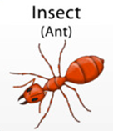
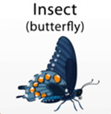
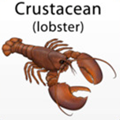
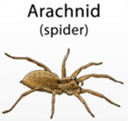
Other examples of Arthropods include:

Slide 14
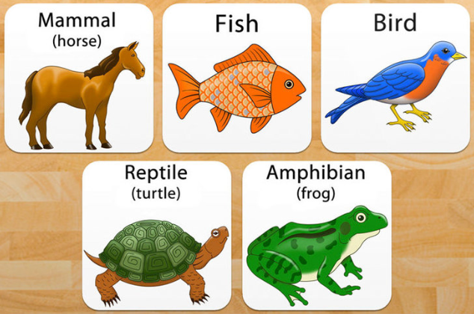
Vertebrates
Fish
Amphians
Reptiles
Aves
Mammals
Marsupials
Placentals
Monotremes
Animals with a backbone

Slide 15
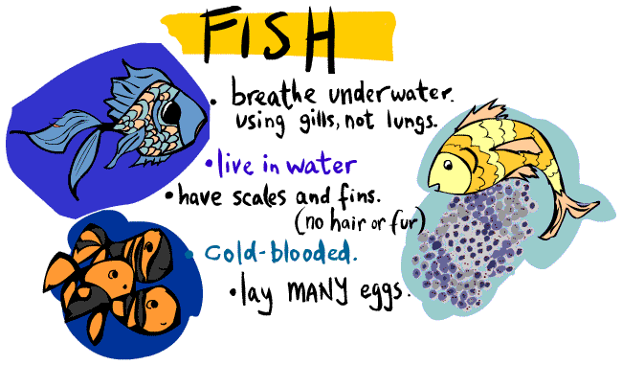

Slide 16
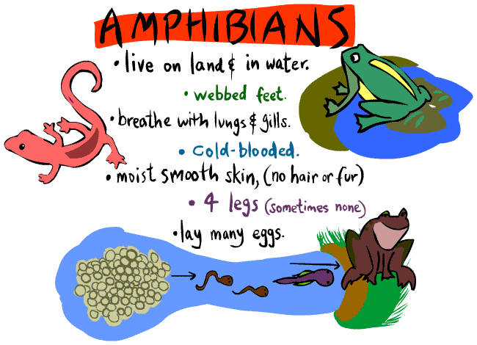

Slide 17
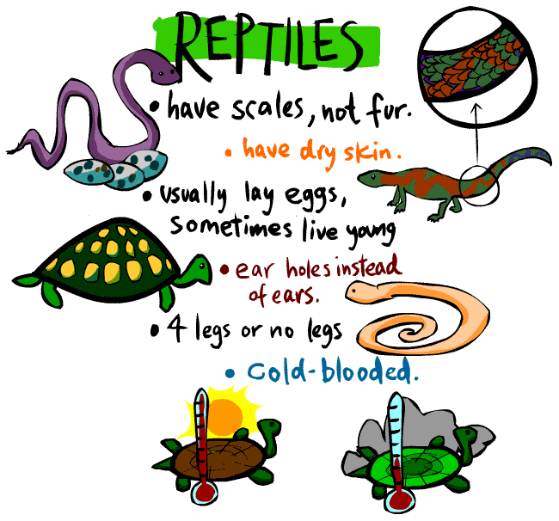

Slide 18
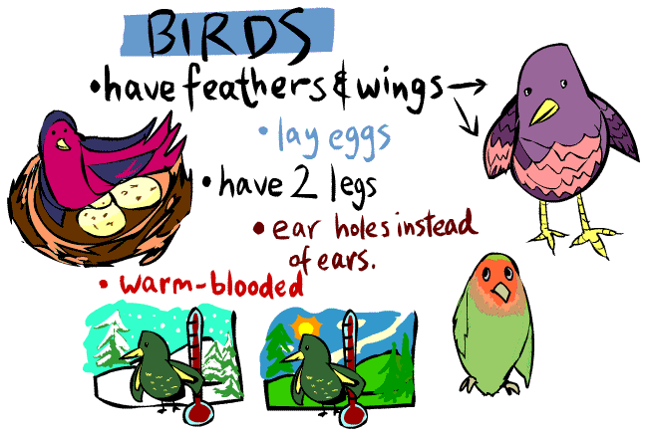

Slide 19
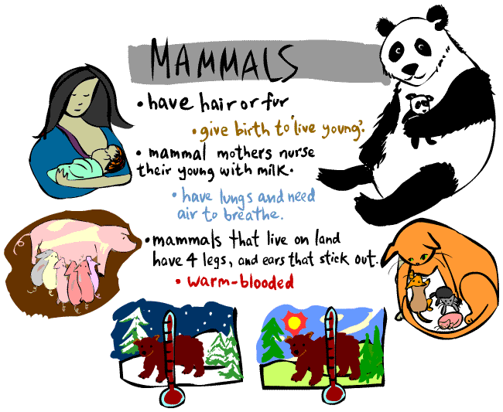

Slide 20
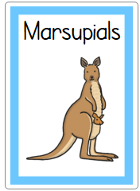
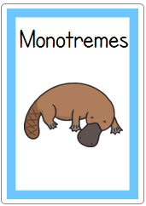
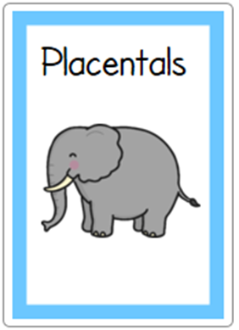
Placentals are mammals in which the baby is nourished inside the mother’s body by a placenta and the baby is born at a more
mature stage.
Eg: human, whale, dog, horse, seal
Marsupials give birth to a tiny undeveloped young that climbs into the pouch where it is fed on milk.
The young marsupial grows and completes its development
in the pouch.
Eg: wombat, kangaroo,
koala, possum
Monotremes are mammals that lay eggs.
Eg: echidna and platypus.

