Slide 1
Forces
Chapter 7

Slide 2
Learning outcomes
Define forces and different types of forces (push or pull)
Measuring forces in Newtons
Balanced vs unbalanced forces
Inertia- what is it and how does it apply to Newton’s first law of motion.

Slide 3
What are forces?
A force is a push, pull or twist that can change an objects motion

Slide 4
What can forces do?
Acceleration: increase in speed
Deceleration: decrease in speed

Slide 5
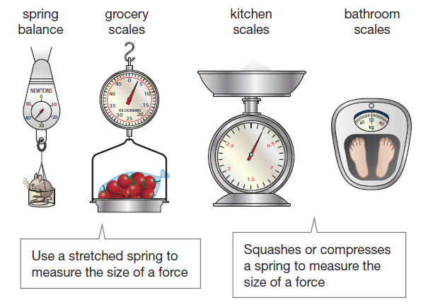
Measuring forces
Force is measured using a unit called newtons (N)
The ability of springs to stretch and squash allow a weight force to be measured
The larger he pulling force, the more the string is stretched, the higher the force

Slide 7
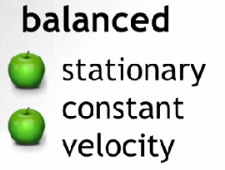
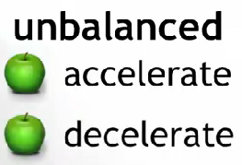
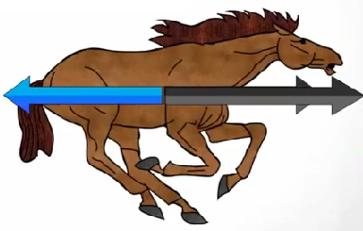
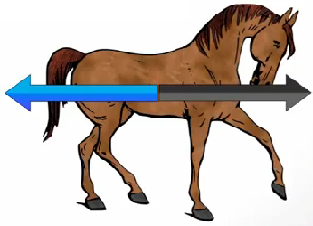
summary
Not moving
Speed

Slide 8
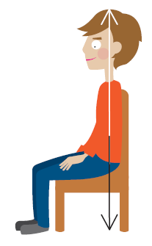
Balanced forces
Note that the arrows are the same length
The downward force of gravity is balanced by the upward support force from the chair. The forces acting on this person are balanced
This is an example of an object that is not moving/stopped

Slide 9
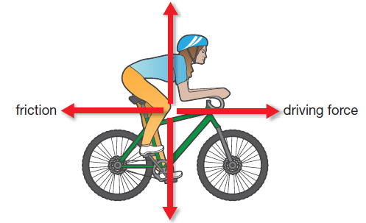
Balanced forces
This is an example of an object travelling at the same speed without changing directions
The forward force from the pedalling is cancelled out by the friction force pushing backwards
The forces at this stage are balanced
forward force
Note that the arrows are the same length

Slide 10
Unbalanced forces
Motion will change when the forces are unbalanced
Forces are unbalanced when:
Start moving (pedalling fast and hard)
Speed up (pedalling fast and hard)
Slows down (using the brakes)
Comes to a stop (using the brakes)
Changes direction (turning the handle bars)

Slide 11
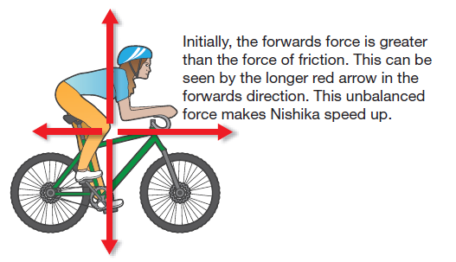
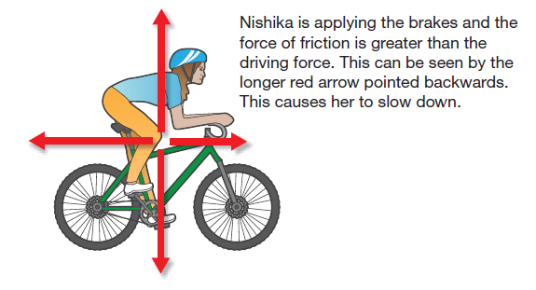
Unbalanced forces
Note that the arrows are now different lengths

Slide 12
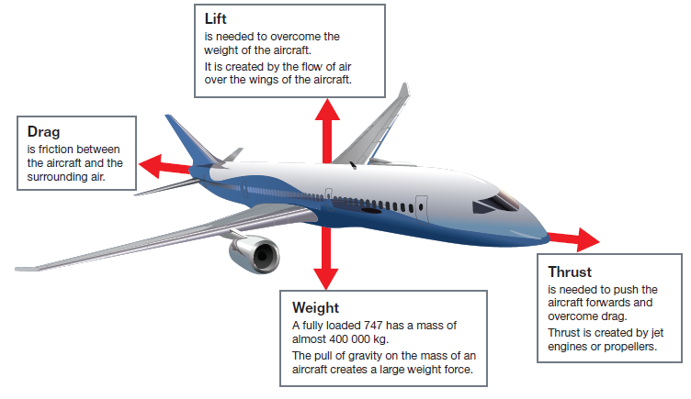
Forces acting on a plane

Slide 13
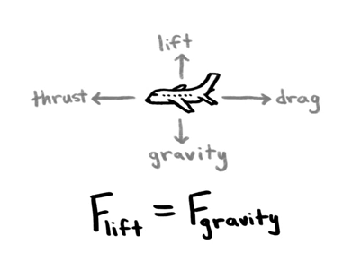

Slide 14
buoyancy
Buoyancy is the upward force on an object that is produced by a surrounding gas or liquid, such as water.
Archimedes figured out that if the weight of the object being placed in the water is less that the weight of the water displaced, the object will float. This is known as buoyancy or the Archimedes principle.

Slide 15
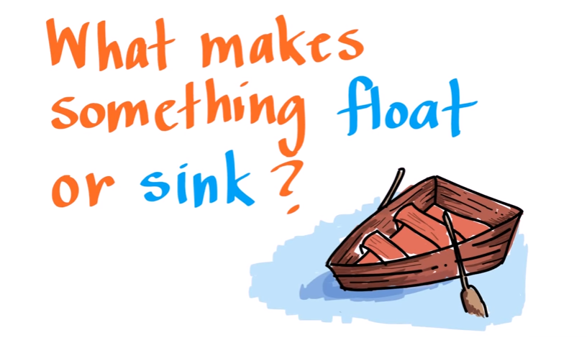

Slide 16
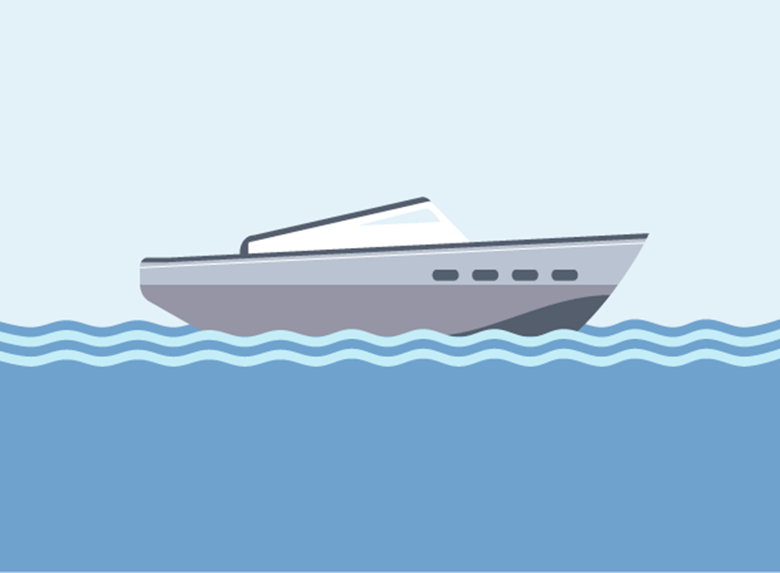
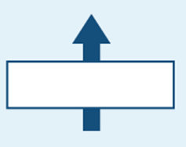
Forces acting on a boat
Buoyancy
Drag/Air resistance
Thrust
Weight/Gravity

Slide 17
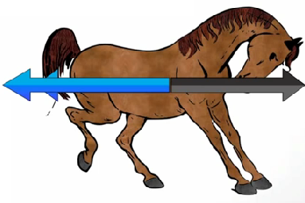
Unbalanced forces summary
Decelerate
Accelerate
Arrow is larger therefore moving forward
Arrow is larger therefore moving backwards

Slide 18
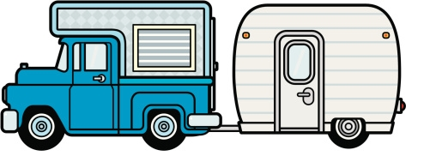
question
Drag from caravan
Driving Force (thrust)
1. State which direction the car is moving
2. Predict what would happen to the speed of the car if the caravan gained extra weight
3. If the car is travelling at a constant speed. Compare the size of the thrust and drag forces acting on the car

Slide 19
Drag from caravan
Driving Force (thrust)
1. State which direction the car is moving
To left or forward
2. Predict what would happen to the speed of the car if the caravan gained extra weight
Decrease as the drag from the caravan will increase
3. If the car is travelling at a constant speed. Compare the size of the thrust and drag forces acting on the car
The thrust balances the drag. No overall force is acting. (Balanced forces = Constant Speed)

Slide 20
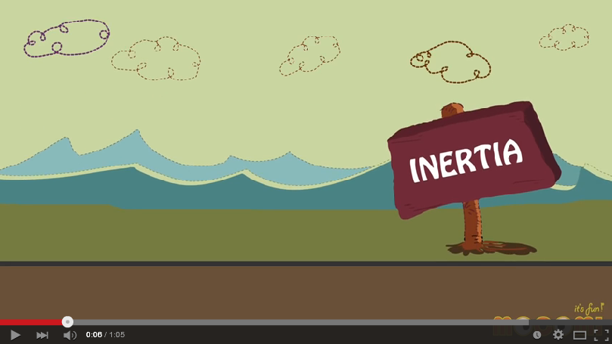

Slide 21
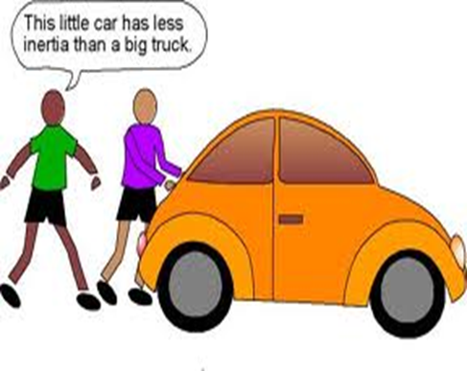
Inertia
Inertia is an object’s resistance to changing its state of motion.
The greater the mass of the object the greater the inertia.
Therefore the greater the mass and inertia the harder and more force is required to change the objects state of motion.

Slide 22
Inertia
The tendency of an object to resist any change in its motion (unless a force is acted upon it)
If you put your school bag down, it will stay there until something happens to it
Someone could lift it, push it or pull it to make it move. When left alone, the bag will not move

Slide 23
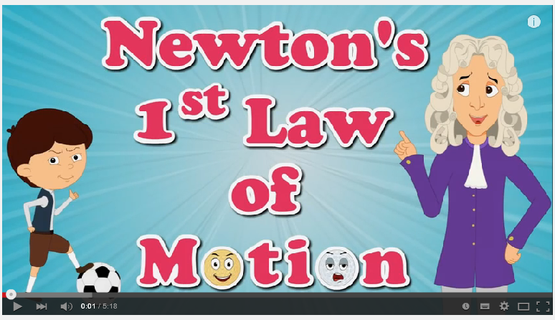

Slide 24
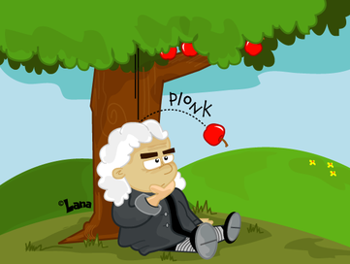
Newtons Law of motion
Sir Isaac Newton proposed some statements to explain the way things move
Anything that is not moving will stay that way unless a force makes it move
Anything that is moving will keep moving at the same speed and in the same direction unless a force makes it change

Slide 25
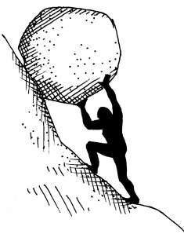
The effect of mass
The more massive something is, the greater its inertia
This means it takes a greater force to change its motion
Eg: it takes a smaller force to stop a pebble roll down a hill than to stop a massive rock

Slide 26
Types of Forces
Contact forces touch an object
Contact
Friction
Pull
Non-Contact
Gravity
Magnetic
Push
Electrostatic
Non-contact forces act at a distance

