Slide 1
Friction
7.2

Slide 2
Learning outcomes
Effects of friction and why it occurs
Examples of useful and non-useful friction in society
The science behind reducing friction

Slide 4
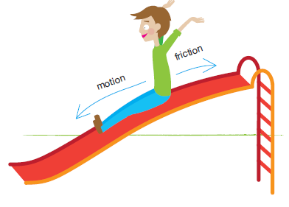
What is friction
Friction occurs whenever one object tries to move over another.
Because it occurs between surfaces in contact, friction is called a contact force.
Friction acts in an opposite direction to motion

Slide 5
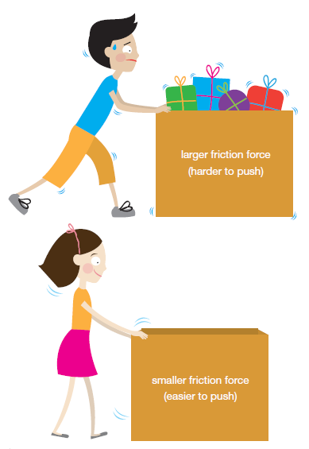
What affects friction?
Friction depends on:
How rough the surfaces in contact are
How hard the surfaces are pushed together.
The greater the weight of a sliding object, the greater the force of friction

Slide 6
Reducing friction
By adding grease to ball bearings, or putting oil into a car, we reduce the friction between moving parts (Lubricant)
Removalists use trolleys to shift refrigerators because rolling surfaces produce less friction than sliding surfaces
Polishing a surfboard helps to make its surface smoother and will reduce friction
Vehicles such as cars and aircraft are all designed to have a streamlined shape. These shapes allow air to flow over and around them more freely, and reduce drag.

