Slide 1
Gravity
7.3

Slide 2
Learning outcomes
Define gravity and gravitational fields
Mass vs. weight
Gravity and orbiting
Spring and Neap tides

Slide 3
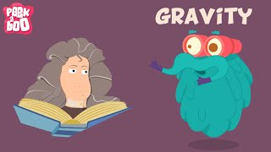

Slide 4
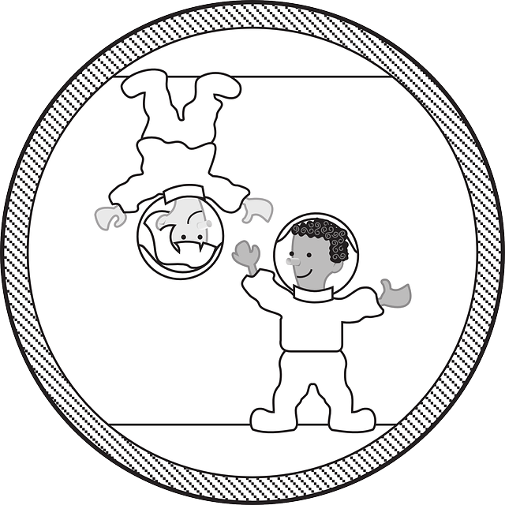
What is Gravity?
Gravity is the force of attraction between two objects
Gravity is a non-contact force that pulls objects to the centre of the earth
The more mass a pair of objects have, the stronger the pulling force of gravity between them.
Distance - The further away from an object you get, the less gravitational pull it will have

Slide 5
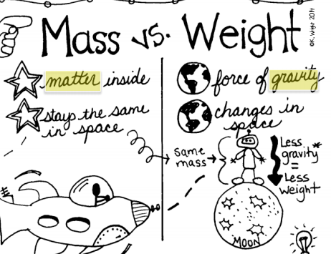
Mass vs weight
Mass is the amount of matter in an object measured in kilograms(kg)
If you were to travel to another planet your mass will not change
Weight is the name given to the pulling force of gravity on an object. Like all forces, weight is measured in newtons (N)

Slide 6
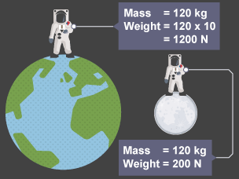
Mass vs weight
Your weight depends on your mass and the strength of the gravitational field of the planet you are on
For this reason, your weight on the moon is 1/6 of that on earth.

Slide 7
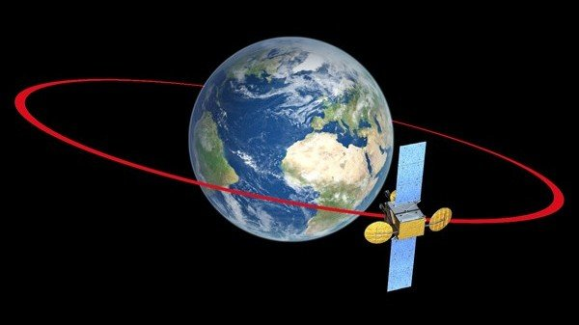
orbits
An orbit is a pathway that a body (planet, moon or star) travels around another body.
It is the gravitational pull of one body on another that holds the smaller body in an orbit

Slide 8
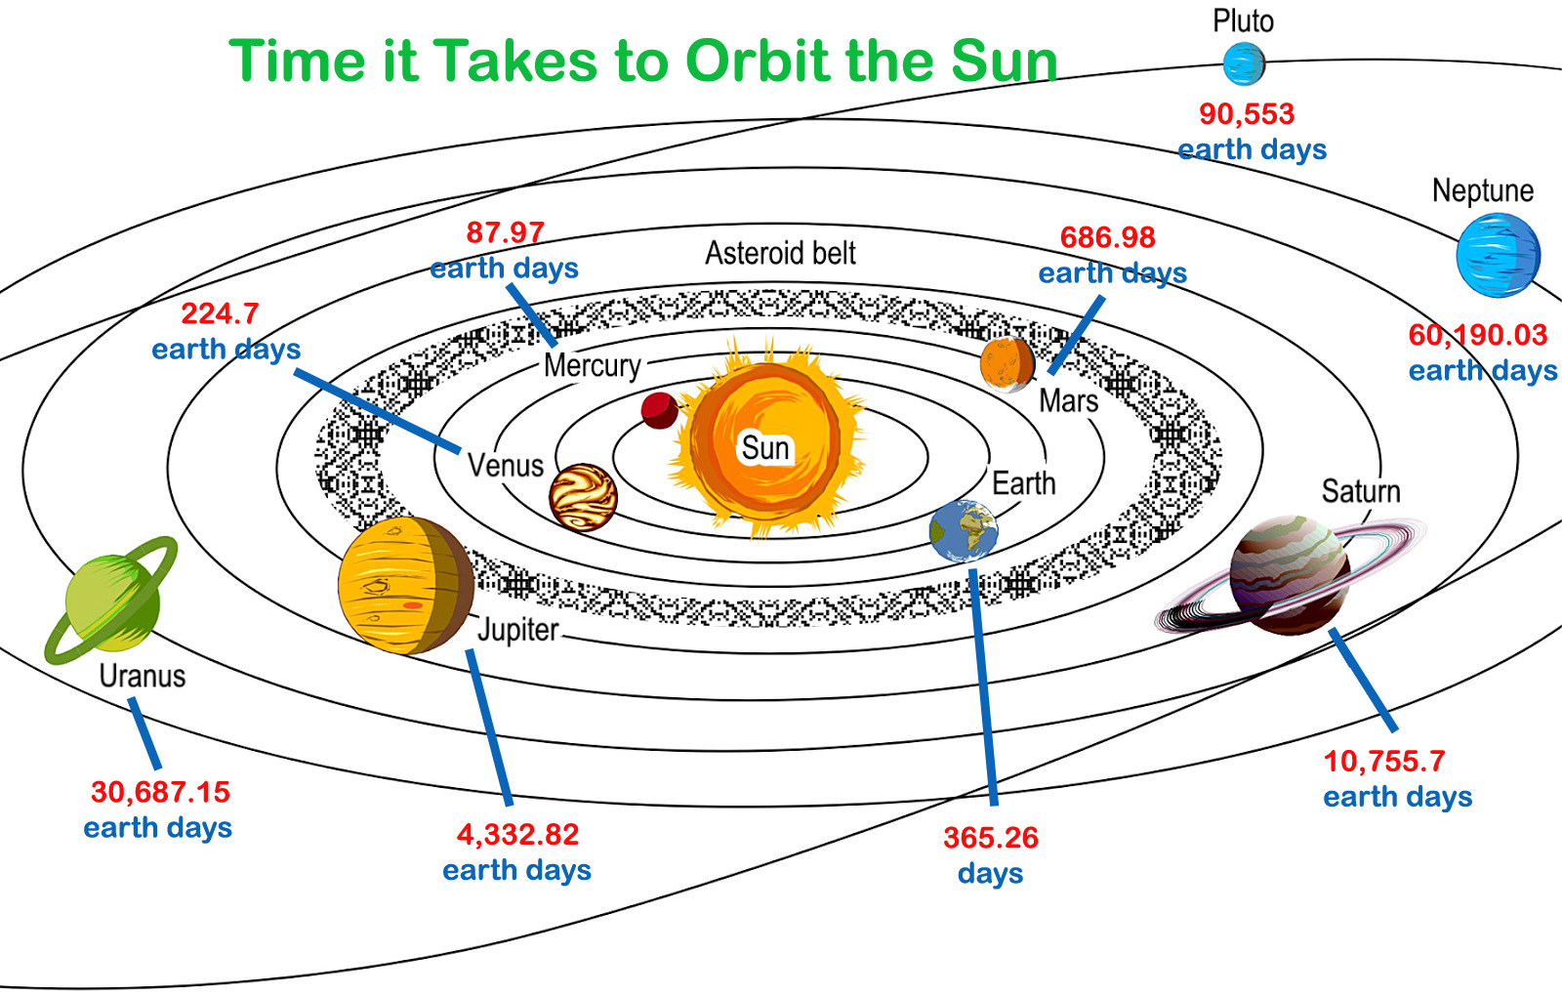

Slide 9
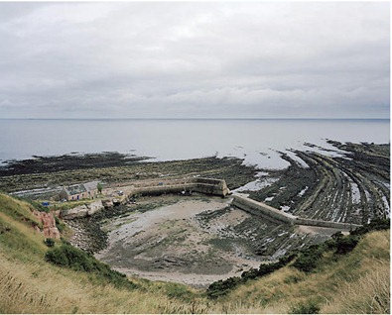
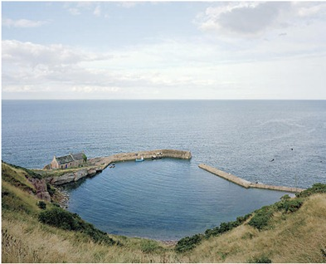
tides
Tides are the rise and fall of the surface levels of Earth’s ocean water caused by the gravitational effects of the Sun and Moon on Earth. ​
As the Moon orbits Earth, the waters of Earth closest to the Moon bulge outward toward the Moon. This bulge is the high tide. Another high tide occurs on the opposite side of Earth. Low tides occur in the areas between the two high tides.​

Slide 10
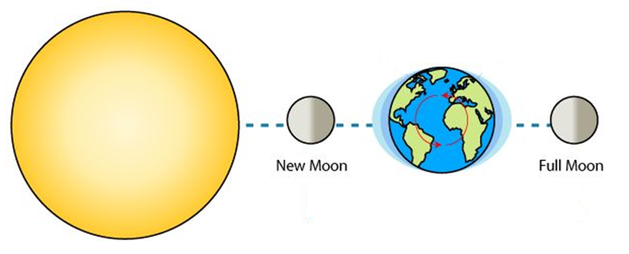
Spring tide
Spring tides occur when the Sun and the Moon are aligned
(the Moon is between the Sun and the Earth (New Moon) or the Earth is between the Sun and the Moon (Full Moon))
High tides are higher and the low tides are lower.

Slide 11
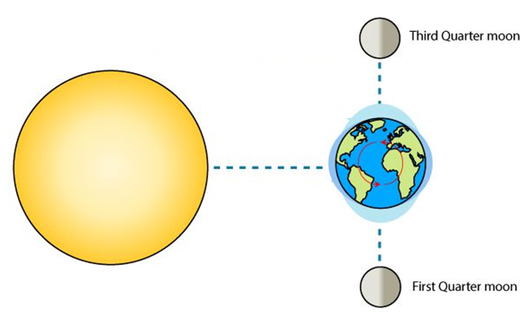
Neap tide
Neap tides occur when the Sun and the Moon are at right angles to each other (first and last quarter).
Lower high tides and higher low tides are experienced.

Slide 12
tides

