Slide 1
Magnetic and electric fields
7.4

Slide 2
Learning outcomes
Magnetic fields
Magnetic poles
Repulsion and attraction
Electrostatic attraction

Slide 3
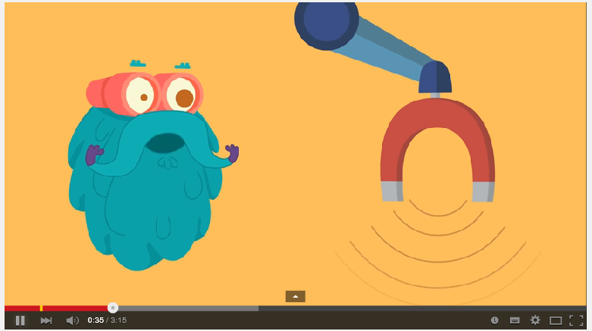

Slide 4
Magnets
A magnet pulls, or attracts, materials containing the metals iron, cobalt or nickel.
A magnetic field is the space around a magnet where a magnetic force is experienced
The ends of a magnet are called poles (north and south)
The magnetic field is strongest at the poles of a magnet

Slide 5
Magnetic fields
A magnetic field is normally invisible to us. Its shape and strength can be determined either by passing a compass around a magnet, or by examining a sprinkling of iron filings around a magnet

Slide 6
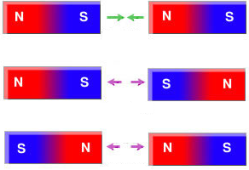
Attraction and repulsion of poles
Unlike Poles
Magnetic poles may be attracted to each other, or repelled by a magnetic force
Like poles will push away/repel each other
Unlike poles will pull together/attract each other
Like Poles

Slide 7
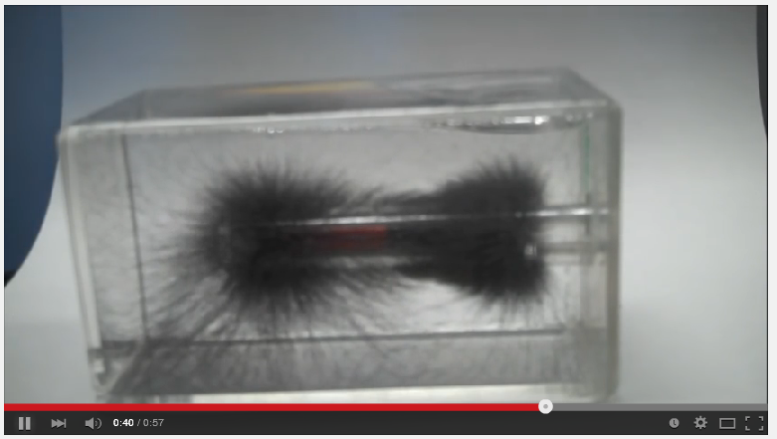
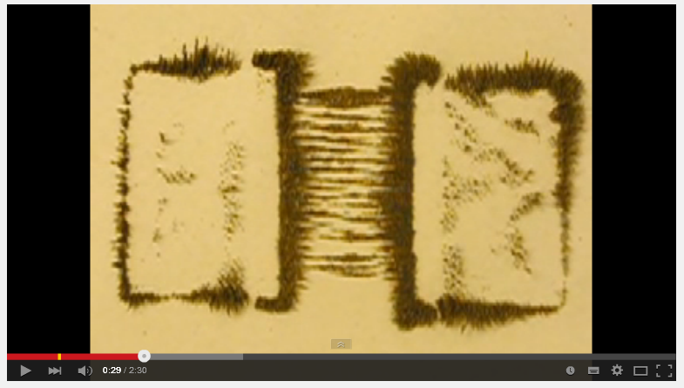
Videos – Magnetic fields

Slide 8
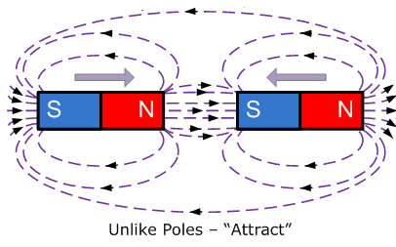
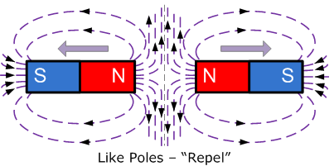
Lines of force around magnets

Slide 9
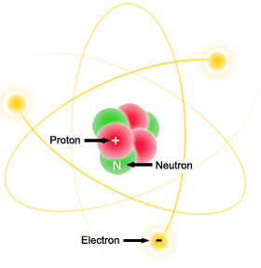
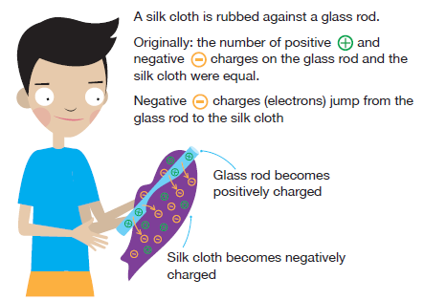
Static Electricity
When an object becomes charged (has unequal numbers of protons and electrons), we say that it has static electricity

