Slide 1
Simple machines - Levers
7.5

Slide 2
Learning outcomes
Define effort, load, fulcrum and simple machines
Describe and give a diagram of the three types of levers (1st, 2nd and 3rd class levers) and give examples of each
Calculate mechanical advantage

Slide 3
Machines
Simple
Machines make it easier to do work over a longer period of time
A simple machine can make a task easier in three different ways. It can:
• change the size of a force
• make things speed up
• change the direction of a force.
An effective machine is one that reduces the amount of effort (force) required

Slide 4
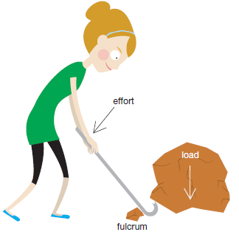
Key words
Effort is the force applied to a lever to overcome the load or get a job done.
Load what is lifted or moved by a simple machine. The force actually required to do the job.
Fulcrum is the pivot point/balance/turning point of a lever

Slide 5
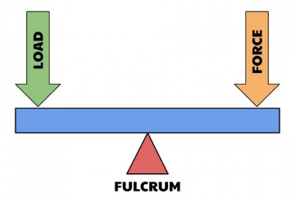
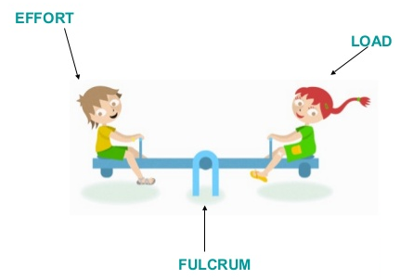
1st class levers
Leavers increase the size of the effort that you can apply or reduce the effort need to get a job done
First class levers – The fulcrum is between the load and the effort.

Slide 6
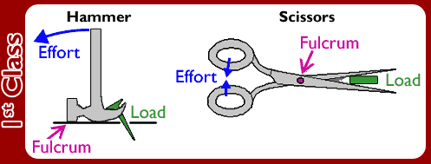
1st class levers

Slide 7
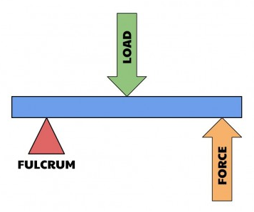
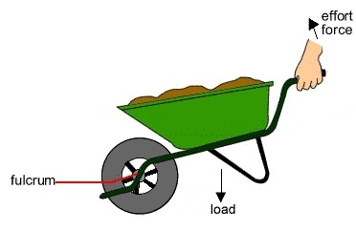
2nd class levers
Second class levers – The load is between the effort and the fulcrum

Slide 8
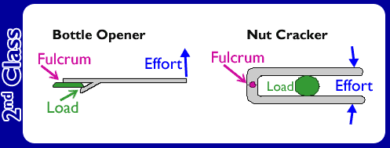
2nd class levers

Slide 9
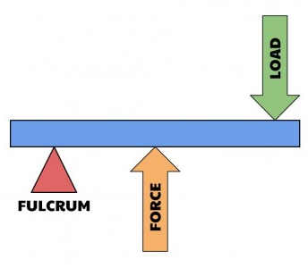
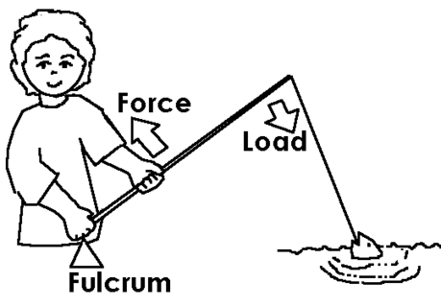
3rd class levers
Third class levers – The effort is between the load and the fulcrum.

Slide 10
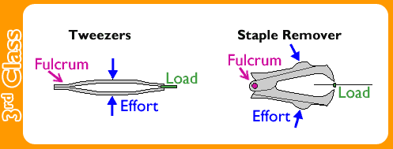
3rd class levers

Slide 11
summary

Slide 12
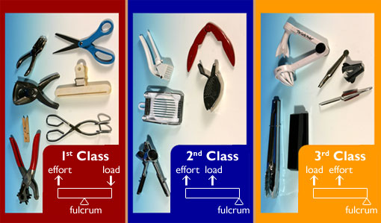

Slide 13
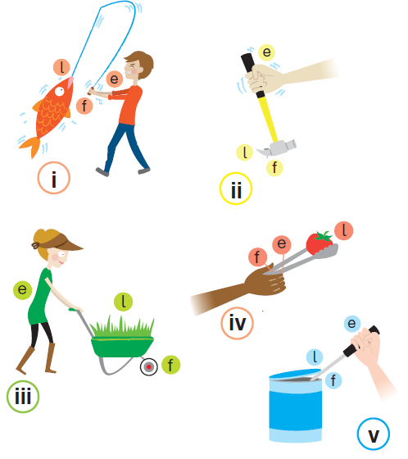
question
State the class of lever acting in each situation

Slide 14
Calculating Mechanical advantage
A simple machine is a device that uses leverage to magnify force. In other words, they make doing work easier. The efficiency of these machines is determined by calculating their mechanical advantage.
Mechanical advantage is a measure of the force amplification attained by the machine or how much easier does the machine make the work?
output force
Mechanical advantage =
input force

Slide 15
Example calculation
Calculate the mechanical advantage of a crowbar that requires a force of 60N to shift a 180N rock
180N rock
crowbar that requires a force of 60N
180N
60N
Mechanical advantage =
= 3

Slide 16
Example calculation
Calculate the mechanical advantage of a machine that requires an effort force of 150N to lift a 750N fridge
750N fridge
effort force of 150N
750N
150N
Mechanical advantage =
= 5

