Slide 1
Graphing skills

Slide 2
Graphs
Tables and graphs are often used to organise and present data.
Graphs can provide a visual representation of the data that is more quickly understood than a large table.
A graph shows patterns or trends in measurements
The type of graph you draw depends on the types of observations you make
Bar Graph
Pie Graph
Column Graph
Line Graph

Slide 3
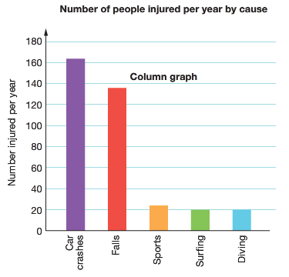
Bar and Column Graphs
Bar and column graphs
Some observations fall into discrete groupings.
This means that all the observations can be sorted into categories and counted.
Bar and column graphs are used when you have a set of observations that are discrete.
These discrete values are displayed on one of the axes of the graph while numbers (count) are displayed on the other axis
Activities that cause injury

Slide 4
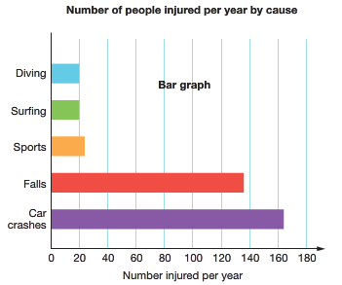
Column vs Bar Graphs
Activities that cause injury
Activities that cause injury

Slide 5
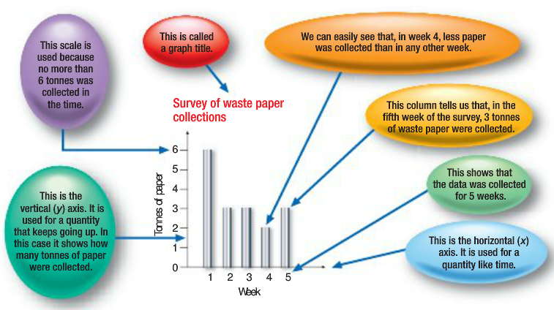
Column Graphs are used for measurements
that aren’t related to each other

Slide 6
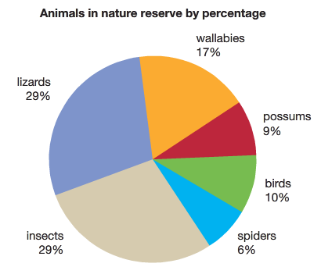
Pie Graph
Pie graphs
Discrete groupings are also used to construct pie graphs or pie charts.
A pie graph shows the proportions (%) of each grouping within a total.
In a pie graph, the whole pie represents 100%, half the pie represents 50% and a quarter-pie represents 25%.
This example shows the percentages of different animals living in a nature reserve.

Slide 7
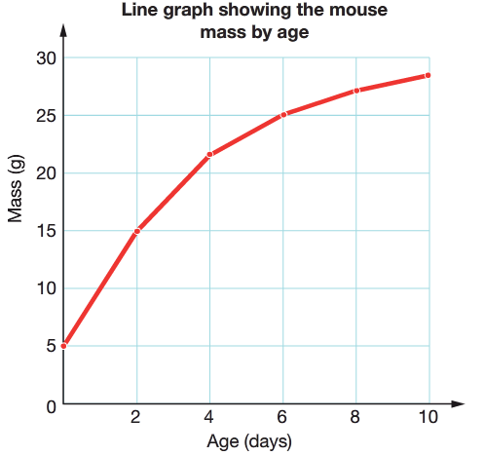
Line Graph
Line graphs
Measurements involve numbers that are not discrete but continuous. This means that if you choose two numbers, then you can always find other numbers in between them Eg: 2, 2.2, 2.5, 2.7, 3
Height, length, mass, time, volume and temperature measurements are continuous
Line graphs require two sets of measurements, that show continuous variation
Line graphs need two sets of numbers to plot

Slide 8
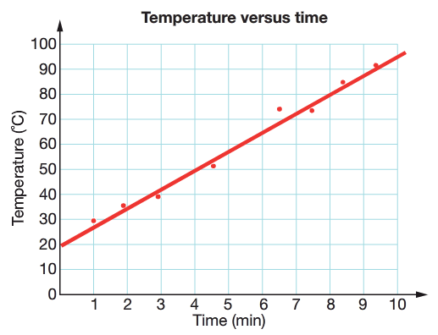
Line graphs
Curve of best fit
Connect the points from one to the next with a curved line (see graph on previous slide)
Line of best fit
The “line of best fit” clearly show patterns that might exist in the measurements you took in the experiment (see graph on this slide)
Draw a straight line through the centre of all the points, making sure you have a balance between the number of points above and below the line

Slide 9
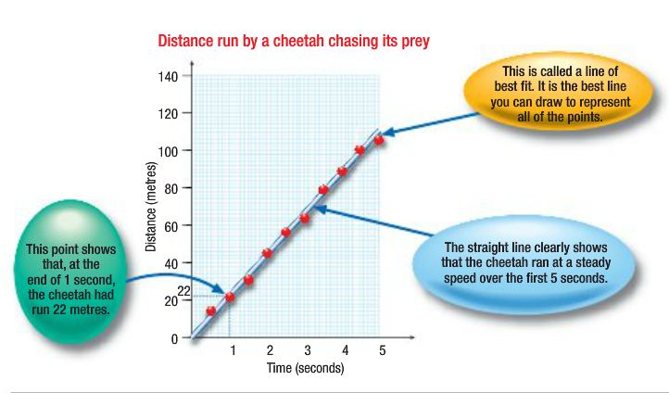
A line graph is useful for measuring
changes in a quantity over time

Slide 10
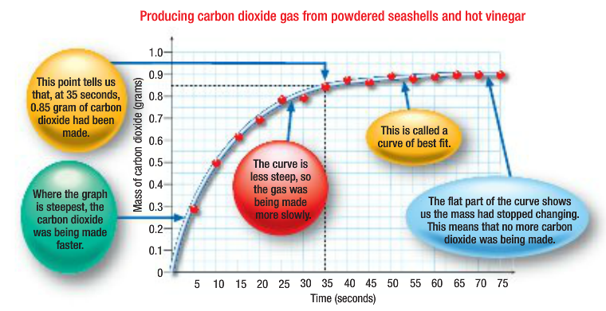
Interpreting a curved line graph

Slide 11
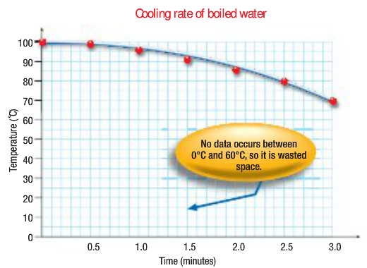
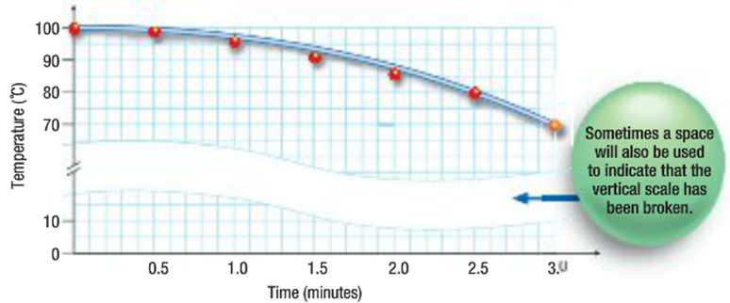
Sometimes an axis would be too log to fit on the page starting at zero. Instead a broken scale can be used.

Slide 12
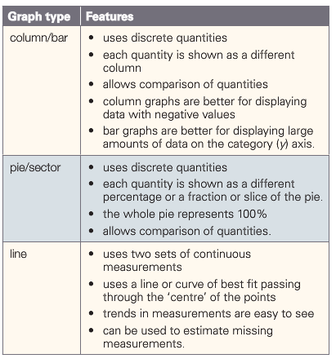
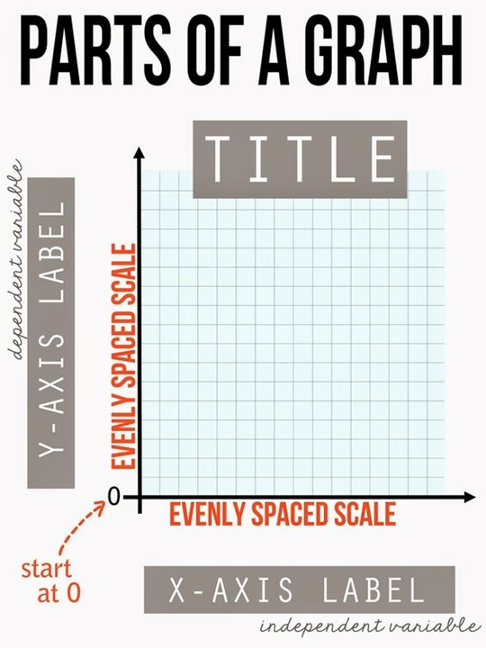
Summary

Slide 13
Graph Checklist
Always use a grey lead and ruler
Label axis and units of measurement
Heading
Key/Legend (sometimes needed)
Spread out graph using the whole page
Spread out numbers evenly on your axis (scale)
Don’t write in the white border of your graph paper

Slide 14
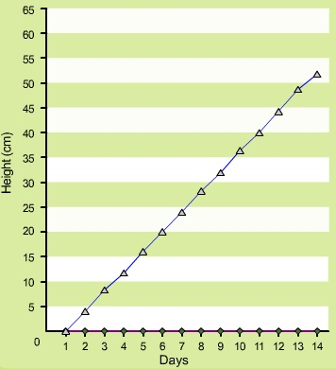
Line Graph Activity
Number of Days | Height of Plant (cm)
1 | 0
2 | 4
3 | 8
4 | 12
5 | 16
6 | 20
7 | 24
8 | 28
9 | 32
10 | 38
11 | 40
12 | 44
13 | 48
14 | 52
This table displays the results obtained from an experiment.
In this experiment, a plant was exposed to sunlight everyday for two weeks.
It was watered the same amount of water each day.
The height of the plant was measured each day.
Plot these results on a line graph

Slide 15
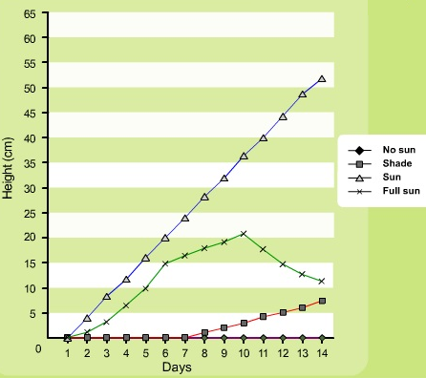
Line Graph Activity
Number of Days | No Sun | Shade | Sun | Full Sun
1 | 0 | 0 | 0 | 0
2 | 0 | 0 | 4 | 1
3 | 0 | 0 | 8 | 3
4 | 0 | 0 | 12 | 6
5 | 0 | 0 | 16 | 10
6 | 0 | 0 | 20 | 15
7 | 0 | 0 | 24 | 17
8 | 0 | 1 | 28 | 18
9 | 0 | 2 | 32 | 19
10 | 0 | 3 | 38 | 21
11 | 0 | 4 | 40 | 18
12 | 0 | 5 | 44 | 15
13 | 0 | 6 | 48 | 13
14 | 0 | 7 | 52 | 12
Furthermore, in this experiment, we tested the effects of sunlight on a plant.
Three plants were added:
No sun
Shade
Full sun
The height of the plants were measured each day.
Plot all of these results on the same line graph so they are easy to compare
Don’t forget to add a key

Slide 16
Module 1.3
Questions
Q1,2,6,7,8,9,10,11
(page 27)

