Slide 1
Variables

Slide 2
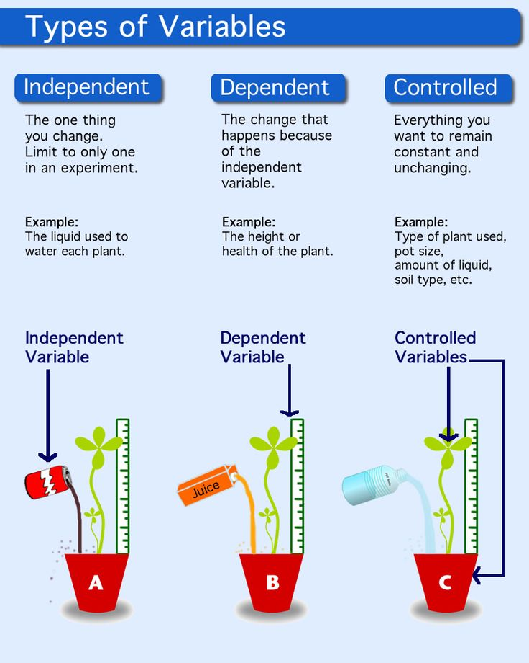

Slide 3
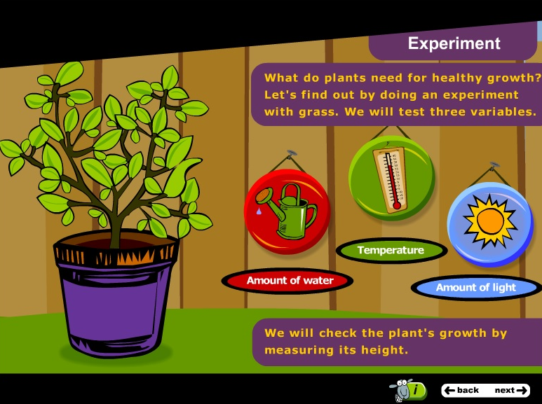
eBook Activity Gloria’s Garden
Log in to Pearson Places--> Resources--> 1.5 Interactive Activities --> Gloria’s Garden

Slide 4
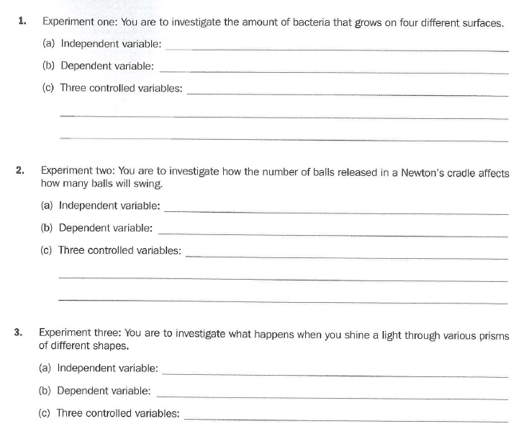
Introducing Variables Worksheet
Four types of growth surface
The amount of bacterial growth (mm)
Incubation temperature, amount of nutrient jelly, initial sample size, period of incubation
The number of balls released
The number of balls that swing out
The mass of the balls, the force used to release the balls, the length of the string in the cradle, the height in which the balls are released
The shape of the prisms
What happens to light
The light source used, the angle of light, the distance, the intensity of light

Slide 5
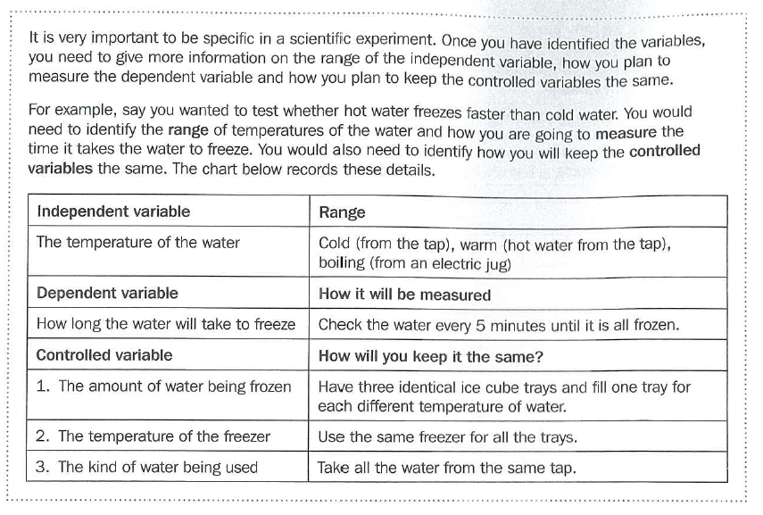
Expanding on Variables Worksheet

Slide 6
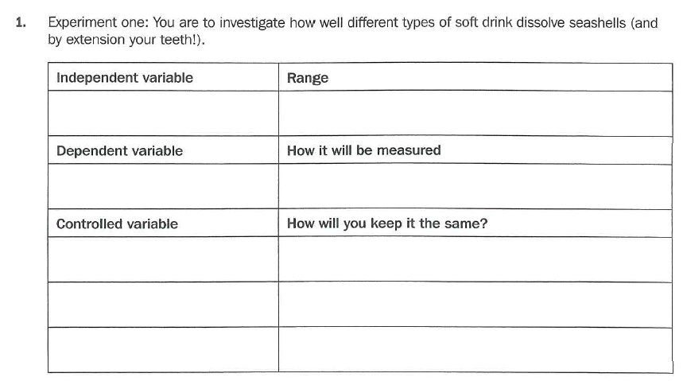
Expanding on Variables Worksheet
Types of soft drink
Four different types of soft drink Eg: coke, 7Up, Solo, Fanta
Mass of shell lost
Weight (g) the shells lose
Amount of soft drink
Use the same volume of drink eg: 100mL
Size of shell
Use shells of the same size
Length of time immersed
Remove shells from drink after set time eg: 5 days

Slide 7
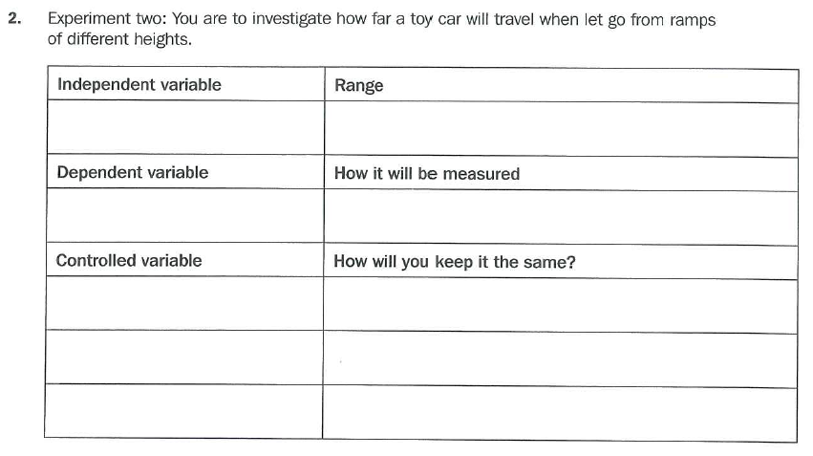
Expanding on Variables Worksheet
Height from which the car is released
4 or 5 sensible heights at regular intervals
eg: 5cm, 10cm, 15cm, 20cm, 25cm
How far the toy car travels
The distance travelled from the bottom of the ramp (cm)
Mass of toy car
Use the same car for all trials
Length of ramp
Use the same point of release on the same ramp
Force of release
Release car from lamp without pushing

Slide 8
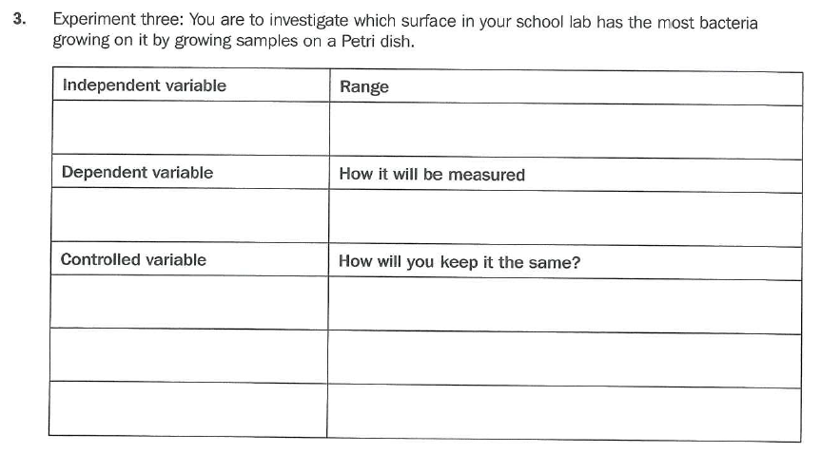
Expanding on Variables Worksheet
Type of surface tested
Three different surfaces eg: door handle, table top,
whiteboard
Bacterial growth
Amount of bacterial growth for each surface (mm)
Same size swab
Use an ear bud to sweep a surface
Time frame
Incubate Bacteria for the same amount of time eg: 24hrs
Growth medium/nutrients
Keep all agar the same with the same amount of nutrients

Slide 9
Activity: Into Science
Log in to Into Science --> Activities --> Science-A journey of discovery --> The Basketball Experiment

