Slide 1
Making Observations

Slide 2
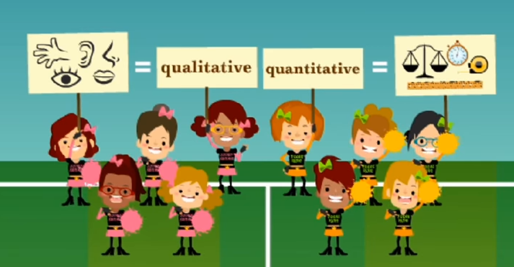
Making Observations
https://www.youtube.com/watch?v=-S2EiPD4-W0

Slide 3
Qualitative Observations
Qualitative observations are descriptive
Recorded as diagrams or words
Use your senses to observe results (sight, smell, touch, taste or hear)
Examples: Colour, long or short, hot or cold

Slide 4
Quantitative Observations
Quantitative observations are written in numbers
Allow scientists to be more detailed and accurate
Observations are measured using rulers, measuring cylinders, thermometers, balances
Examples: Distance, Mass, Temperature, Volume, Time

Slide 5
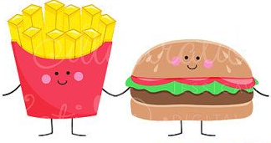
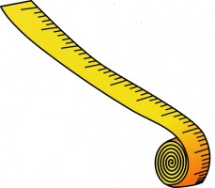
Worksheet: Making Observations
The taste of food
_________________________________
The distance between home and school
_________________________________
The mass of your textbook
_________________________________
The temperature outside in degrees
_________________________________
Time taken to run 100m
_________________________________
The colour of petals on a flower
_________________________________
The sound a bird makes
_________________________________
The feel of the temperature outside
_________________________________
Qualitative
Quantitative
Quantitative
Qualitative
Quantitative
Qualitative
Quantitative
Qualitative

Slide 6
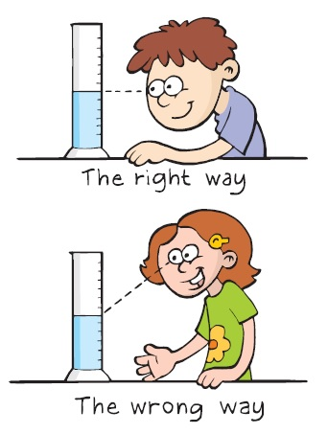
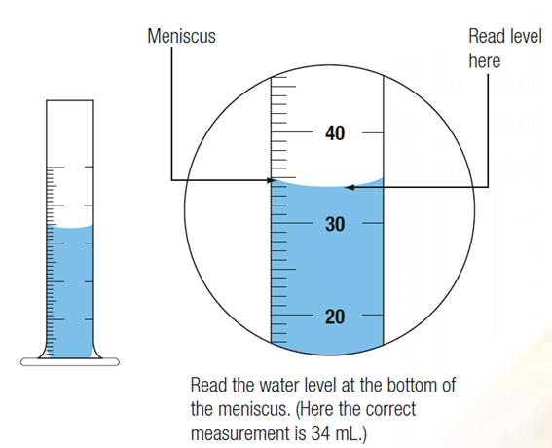
Measuring Liquids – Meniscus
The meniscus is the curved shape we see in a thin container of liquid.

