Slide 1
Bunsen Burner

Slide 2
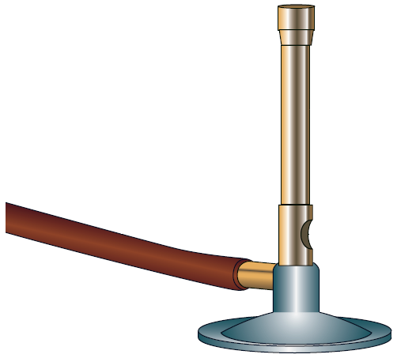
Bunsen Burner
An important piece of equipment used for heating in the lab.
Can be very dangerous if care is not taken.

Slide 3
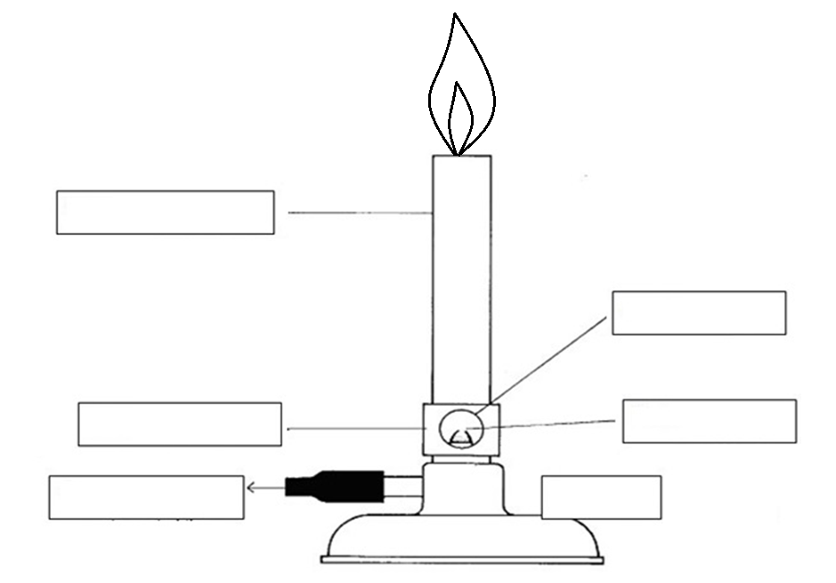
Parts of the Bunsen Burner
Hottest part of the flame
Barrel
Air hole
Collar
Gas Jet
Gas Hose
Base

Slide 4
Pearson Places Interactive
Ebook → Resources → Chapter 1 - Investigating Science → Interactive Activities → Lighting a Bunsen Burner

Slide 5
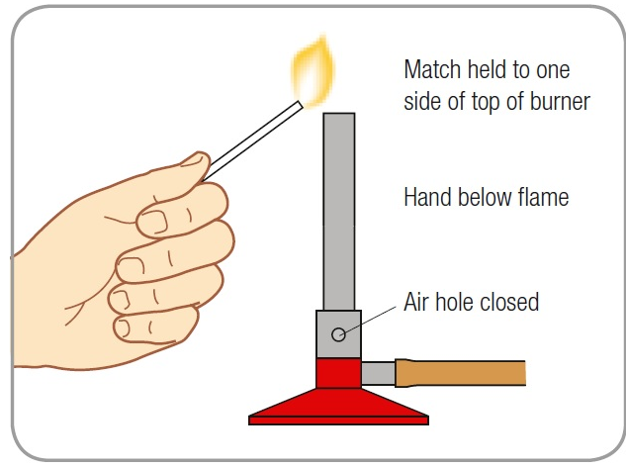
How to light a Bunsen Burner
Connect hose to gas tap
Make sure the air hole is closed
LIGHT THE MATCH and place near the top of the Bunsen burner
Turn on gas LAST

Slide 6
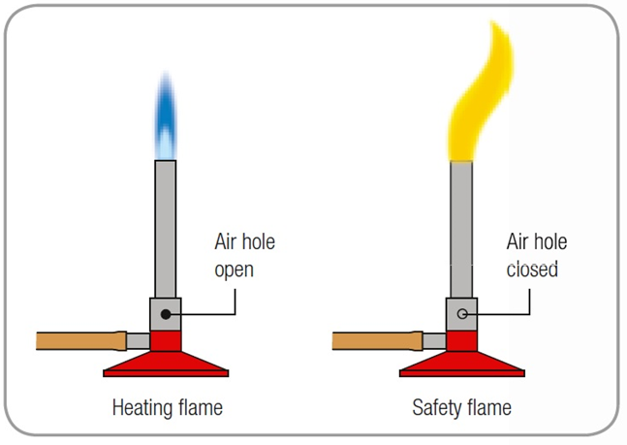
Different Flames

Slide 7
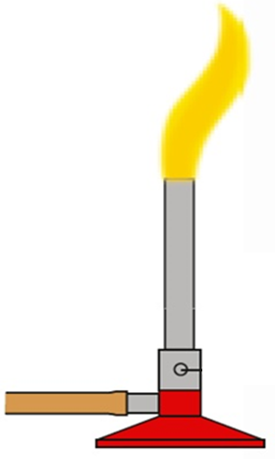
Characteristics of the Yellow Flame
Air holes closed
Safety Flame
Relatively Cool
Highly Visible
Dirty Flame

Slide 8
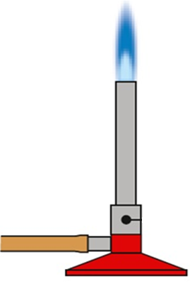
Characteristics of the Blue Flame
Air holes open
Heating Flame
Relatively Hot
Difficult to see
Clean Flame

Slide 9
ACTIVITY: How to light a Bunsen Burner?
You are to complete the cut and paste activity matching the pictures to their description AND put them in order to show how to light a
Bunsen Burner correctly
Show your teacher before you stick them into your book

Slide 11
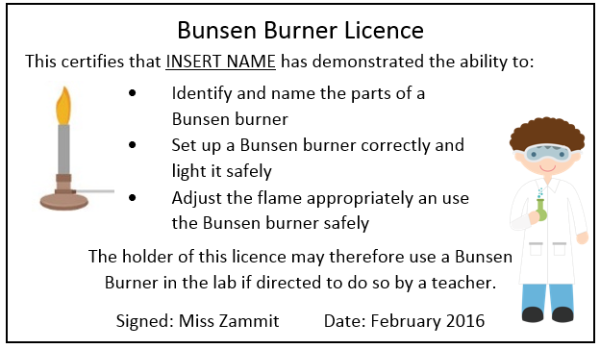
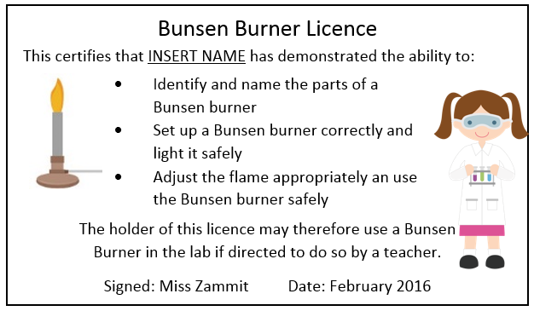
How to obtain your Bunsen Burner Licence
Theory Test
Practical Test
Pass both successfully
Licence!!!

