Slide 1
Scientific Method

Slide 2
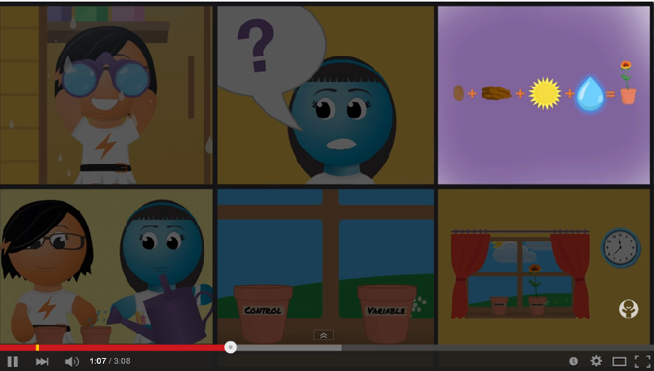
Scientific Method
https://www.youtube.com/watch?v=KIFz_-KzURY

Slide 3
Scientific Report Writing
Aim
Materials
Method
Hypothesis
Results
Discussion
Conclusion
When completing a practical activity we always write up a scientific report.
Scientific reports are used by scientists to communicate to other scientists how they performed an experiment and what they found out in it.
Reports have the following structure:

Slide 4
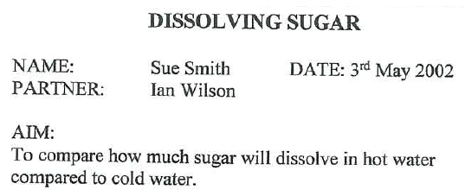
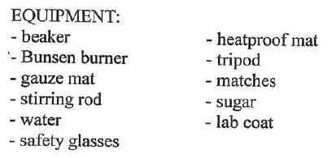
Scientific Report Writing
Aim or purpose
The aim or purpose is what you wanted to do in an
experiment or practical activity, what you wanted to
show or wanted to prove.
Hypothesis (optional)
You probably have some idea of what might happen in
an experiment even before you start it. This ‘educated
guess’ is called your hypothesis. A hypothesis is an
inference based on what you already know. A hypothesis
is not always included in a scientific report.
HYPOTHESIS:
More sugar will dissolve in hot water then will in cold water
Materials
This is a list of all the important equipment, chemicals
and materials that you used. If equipment comes in
different sizes, then make sure you include the size you
used (for example, 250 mL beaker).

Slide 5
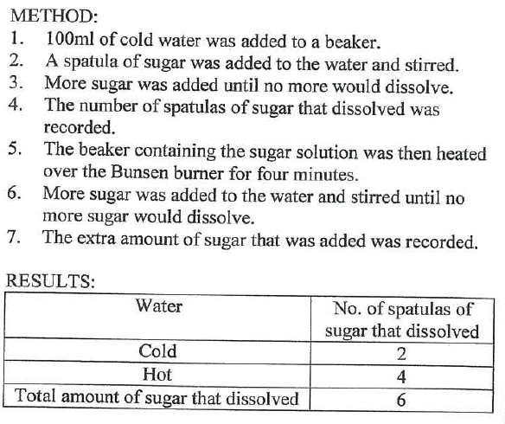
Scientific Report Writing
Method or procedure
The method or procedure is a detailed list (always written in steps) of what you did in the experiment. You must include what quantities were used (for example, 5 g, 2 spatula loads or 10 mL), and the exact order in which the steps of the experiment were performed. A diagram of the experiment is a useful way of showing what you did.
Results
Results include all your observations and all your
measurements, preferably displayed in a table and sometimes a graph.
Measurements and observations are easier to read and
analyse if they are displayed in tables.

Slide 6
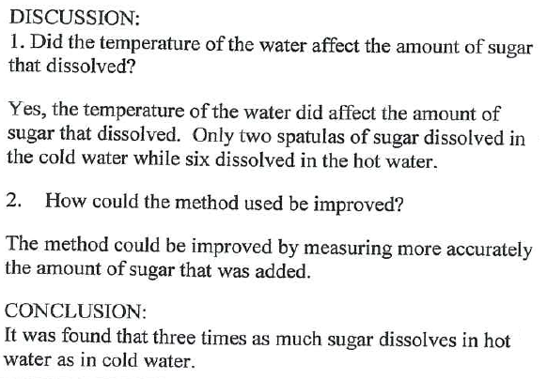
Scientific Report Writing
Discussion or analysis
Include in your discussion or analysis:
• answers to any questions asked in the activity
• any graphs you plotted
• an explanation about what you think your results
showed about the experiment
• what you have found about the experiment from other
sources such as textbooks, the internet or encyclopaedia's
• a description of any problems you had with the
experiment and what you did to overcome them.
Conclusion
Your conclusion needs to summarise what you have
found out in the experiment. The conclusion should be
short and must relate to the purpose.

Slide 7
Into Science Activity
Log in to Into Science --> Activities --> Science-A journey of discovery --> Order of the Scientific Method

Slide 8
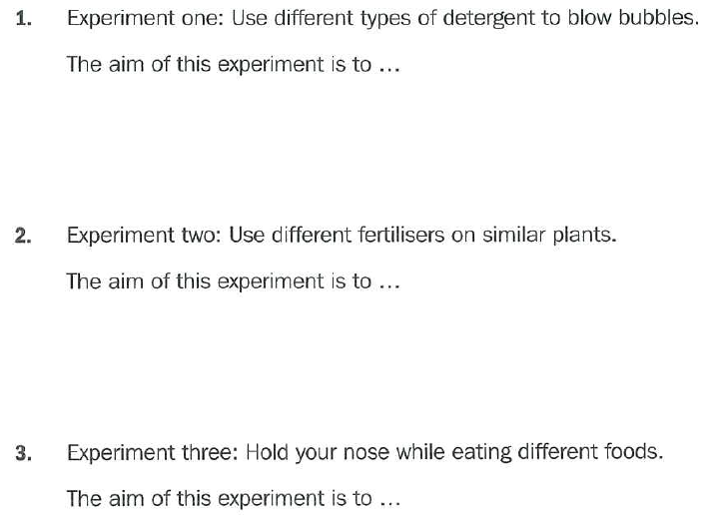
Aim/Purpose Worksheet
See which type of detergent makes the biggest bubbles
See which type of fertiliser makes plants grow best
See if your sense of smell affects your sense of taste

Slide 9
Aim/Purpose Worksheet
See how different curved surfaces affect the reflection of light
See which type of cereal contains the most iron

Slide 10
Conclusion Worksheet
Our results show that the toy car travels faster along a smooth surface than a rough surface

Slide 11
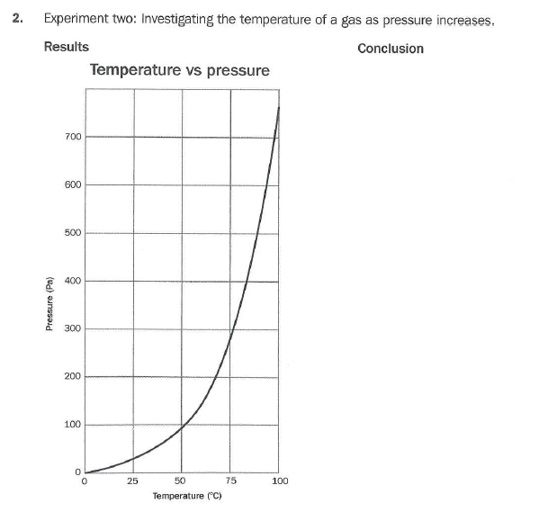
Conclusion Worksheet
Our results show that the temperature of the gas increases as the pressure of the container increases

