Slide 1
Graphing skills

Slide 2
Graphs
A graph shows trends in measurements even more clearly than tables do.
The type of graph you draw depends on the types of observations you make
Pie Graph
Bar Graph
Line Graph

Slide 3
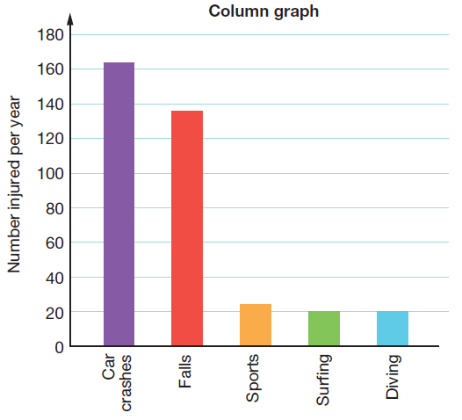
Bar and Column Graphs
Bar and column graphs
Some observations fall into discrete groupings.
This means that all the observations can be sorted into categories and counted. Animals, for example, fall into discrete groupings like kangaroos, ants, cockatoos and sharks
Bar and column graphs are used when you have a set of observations that are discrete.
These discrete values are displayed on one of the axes of the graph while numbers are displayed on the other axis

Slide 4
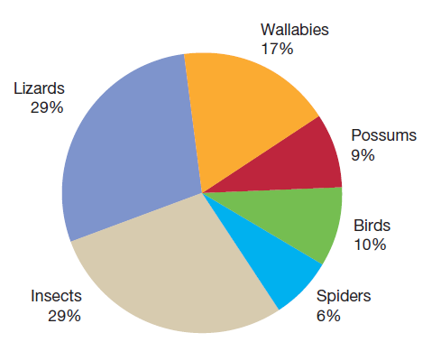
Pie Graph
Pie graphs
Discrete groupings are also used to construct pie graphs or pie charts.
A pie graph shows the proportions of each grouping within a total.
In a pie graph, the whole pie represents 100%, half the pie represents 50% and a quarter-pie represents 25%.
This example shows the percentages of different animals living in a nature reserve.

Slide 5
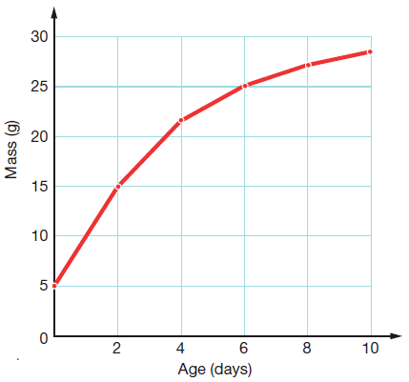
Line Graph
Line graphs
Measurements involve numbers that are not discrete but continuous. This means that if you choose two numbers, then you can always find other numbers in between them Eg: 2, 2.2, 2.5, 2.7, 3
Height, length, mass, time, volume and temperature measurements are continuous
Line graphs require two sets of measurements, that show continuous variation
Line graphs need two sets of numbers to plot

Slide 6
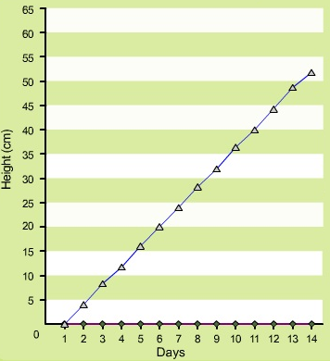
Line Graph
Number of Days | Height of Plant (cm)
1 | 0
2 | 4
3 | 8
4 | 12
5 | 16
6 | 20
7 | 24
8 | 28
9 | 32
10 | 38
11 | 40
12 | 44
13 | 48
14 | 52
This table displays the results obtained from an experiment.
In this experiment, a plant was exposed to sunlight everyday for two weeks.
It was watered the same amount of water each day.
The height of the plant was measured each day.
Plot these results on a line graph

Slide 7
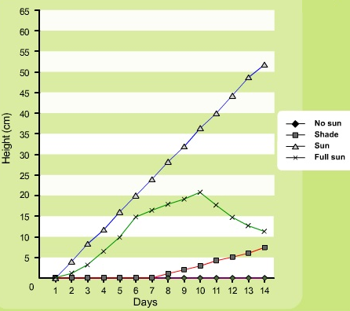
Line Graph
Number of Days | No Sun | Shade | Sun | Full Sun
1 | 0 | 0 | 0 | 0
2 | 0 | 0 | 4 | 1
3 | 0 | 0 | 8 | 3
4 | 0 | 0 | 12 | 6
5 | 0 | 0 | 16 | 10
6 | 0 | 0 | 20 | 15
7 | 0 | 0 | 24 | 17
8 | 0 | 1 | 28 | 18
9 | 0 | 2 | 32 | 19
10 | 0 | 3 | 38 | 21
11 | 0 | 4 | 40 | 18
12 | 0 | 5 | 44 | 15
13 | 0 | 6 | 48 | 13
14 | 0 | 7 | 52 | 12
Furthermore, in this experiment, we tested the effects of sunlight on a plant.
Three plants were added:
No sun
Shade
Full sun
The height of the plants were measured each day.
Plot all of these results on the same line graph so they are easy to compare
Don’t forget to add a key

