Slide 1
Types of Mixtures
4.1 Chapter Review

Slide 2
1. List two examples each of a solute, a solvent and a solution.
solute—an example such as salt, sugar
solvent—an example such as water, kerosene
solution—an example such as salt solution, sugar solution

Slide 3
2. List four types of solution and give an example of each.

Slide 4
3. List three types of suspension and give an example of each.

Slide 5
5. Recall the different types of mixtures

Slide 6
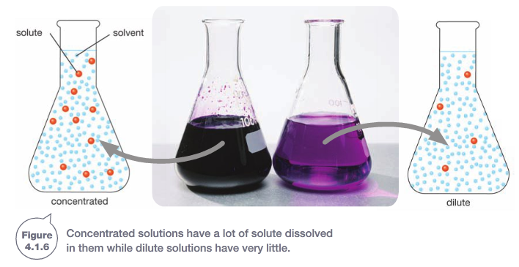
8. Explain the meaning of the term concentrated solution
A concentrated salt solution has a large amount of salt in a particular volume of solution, whereas a dilute solution has much less salt dissolved in the same amount of water

Slide 7
9. Identify what is wrong in the following statements and re-write them accurately.
(a) A solvent is defined as a substance that dissolves a solid to form a solution.
A solvents can dissolve a liquid or a gas as well as a solid. A solvent is defined as a substance that dissolves a solid, liquid or gas to form a solution.
(b) An emulsion can be the solution formed when liquids disperse through water.
An emulsion is not a solution. A solution is when a solute dissolves in the medium (solvent).
(c) To form a suspension, a solid has to be fine enough to stay dispersed in a medium.
A suspension does not stay dispersed for long. It usually separates out quite quickly from the medium.

Slide 8
9. Identify what is wrong in the following statements and re-write them accurately.
(d) Colloids are composed of particles larger than those in a solution or a suspension
Colloid particles are smaller than those in a suspension.
(e) An emulsifier can be used to make a solution.
Emulsifiers produce emulsions, not solutions: the substance does not dissolve in the medium.
(f) All solutions are mixtures, but a suspension is not a mixture.
A suspension is a mixture because it consists of particles in a dispersal medium.

Slide 9
12. How could you demonstrate that a sugar solution is just saturated?
Add some more sugar and watch to see if it collects on the bottom and will not dissolve. If it does settle, the solution is saturated.
Both have water as the liquid medium. The sugar particles are too small to see because they are dissolved and remain in between the water particles. The sand particles are large enough to see individually and will settle to the bottom.
14. Compare a sugar solution with a suspension of sand in water.

Slide 10
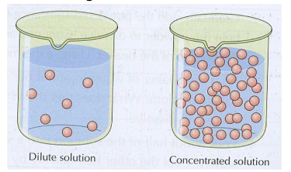
13. Compare a concentrated sugar solution with a dilute sugar solution
Both have water as the solvent and contain sugar. However, the concentrated solution has much more sugar dissolved in the same amount of water.

Slide 11
16. Classify each of the following as solution, suspension or colloid.

Slide 12
17. Compare a solution, a suspension and a colloid
In a solution, the solute particles dissolve into particles of similar size to the solvent medium.
In a suspension, the suspended particles do not dissolve and stay dispersed for only a short while in the medium, eventually settling to the bottom.
In a colloid, the particles are in between the size of a solution and a suspension, and stay dispersed in the medium.

Slide 13
Separating Insoluble Substances
4.2 Chapter Review

Slide 14
1. List examples of sieving and filtering around your home.
2. Name an example of centrifuging that is used at home.
coffee percolator,
tea bags,
vacuum cleaner,
air conditioner,
car engine,
car air cleaner,
washing machine,
clothes dryer,
face mask.
Spin-drying with a washing machine,
Salad spinner

Slide 15
2.

Slide 16
3. State at least two methods of separation that can be used to separate:

Slide 17
4a Describe what a paper filter would look like if you could magnify it enough. b Explain how it works to filter out larger particles
There would be a barrier with many small holes through it. (The barrier is actually many fine fibres of wood in a random pattern and the holes are the gaps between the fibres.)
The large particles cannot fit through the holes.

Slide 18
6 Describe how magnetic separation can be used to separate magnetic and non-magnetic metals from household rubbish.
5 Explain why filtration cannot separate sugar from water.
The sugar particles are smaller than the holes in the filter, so they can pass through.
Scrap metal is fed onto a conveyor belt which passes near a magnetic rotating drum. The magnetic materials are attracted to the drum and are removed from the flow of rubbish, which passes straight through.

Slide 19
7 Identify a method of separation that could be used or the following situations.
a You want some fine clean sand without any sticks or stones from the soil in your garden.
Find some old insect wire or buy some. Support it and shovel the soil onto it. Shake the wire to sieve out the sticks and stones.
b You drop some nails into the sand in your back yard.
Use a magnet or try panning like you did in the science4fun activity.
c You drop some hundreds-and-thousands into the flour your mum is using for a cake.
Use a flour sifter to sift out the hundreds and thousands.
.

Slide 20
d The gravel border along the driveway at home has become covered by bark, and leaves and fine sticks are mixed with the gravel.
Shovel the mixture into a bucket of water. The plant material will float and can be skimmed off.
e Your tea bag breaks in your cup of tea
Use a tea strainer or flour sifter. Tip the liquid through the sifter or strainer into another cup.

Slide 21
10. Compare filtering and sieving.
Filtering and sieving both use a barrier with holes in it to prevent a solid passing through. Filters are usually thought of as being composed of microscopically small holes. A sieve has holes you can see and separates out particles big enough to see.
Get two beakers, filter funnel, filter paper, filter stand and water. Put the sand and salt into a beaker and add water. Stir the mixture to dissolve the salt. You may have to add more water if the salt will not all dissolve. When the salt is all dissolved, filter the liquid. The sand stays in the filter paper and the salt is in the filtrate.
12. In the laboratory, you are given a mixture of sand
and salt. Propose a way of separating these two
substances.

Slide 22
Separating Soluble Substances
4.3 Chapter Review

Slide 23
1. Recall methods of separating mixtures by matching each method with its correct description.
A A method that uses substances with a large surface area to remove chemicals from water and air
adsorption
B A process using evaporation and condensation to separate and recover both solute and solvent
distillation
C A process that can separate a mixture by making it move through another substance like a paper strip
chromatography
D A process in which heat changes a liquid into a gas, allowing recovery of a solute but not the solvent
evaporation

Slide 24
2. From the examples in this unit, name the separation process used to:
a separate different coloured substances from food colouring or ink
chromatography
b collect salt crystals from seawater
evaporation
c make alcoholic drinks like bourbon and whisky
distillation
d remove poisonous substances from the stomach contents of a dog.
adsorption

Slide 25
4. Explain the process by which distillation can separate a solute and a solvent and allow you to recover both substances.
3. Explain the process by which chromatography can separate substances.
Chromatography is a process that can separate a mixture by making it move through another substance like a paper strip. Chromatography works because all the chemicals in the mixture are attracted to the paper by different amounts. Chemicals that are strongly attracted eventually stick to the paper, so they stop moving before the ones that are weakly attracted.
Distillation uses a heat source such as a Bunsen burner to quickly boil a solution in a flask. The solvent (usually water) evaporates. The gas then passes into a water-cooled tube called the condenser, where it condenses back to liquid. The distillate drips into a flask. The solute remaining in the heated flask is called the residue. The distillate will be very pure because the solutes do not evaporate and pass into the condenser.

Slide 26
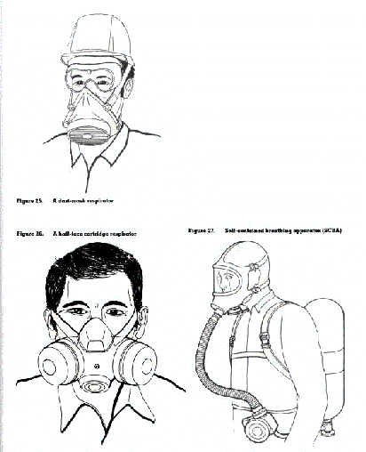
6. Explain how a face mask can protect workers in a mineshaft by removing dangerous gases from the air.
The face mask has a filter that can adsorb gases
from the air. The gases stick to the carbon filter
before they can enter the miners’ airways.

Slide 27
7. Identify a separation method that could be used for each of the following purposes
a) To test whether a particular ink is a mixture of colours
chromatography
b) To purify water from a washing machine enough to drink it
distillation
c) To recover the sugar from a bag that you accidentally dropped into a saucepan of water while you were cooking
evaporation
d) To remove smells from the air inside a car using the air-conditioning system
adsorption filter

Slide 28
10. A whisky maker wants to reduce the amount of water in a mixture to give a higher concentration of alcohol. Justify the choice of distillation rather than evaporation as a separation method. Note that alcohol boils at 78°C and water boils at 100°C.
With evaporation, the alcohol will boil off first and be lost, so the whisky will become lower in alcohol. With distillation, the alcohol will evaporate first and be collected as the distillate. Then the producer can add water to it to achieve the required strength.

Slide 29
12. When your dry your bathers after swimming in the sea, they are crisp with salt. However, if you rinse them in fresh water first, they dry clean and salt-free. Propose why the two methods of drying produce such different results
When you leave the bathers containing salt water to dry in air, the salt remains behind and forms crystals as the water evaporates. When you rinse the bathers in fresh water, it removes most or all of the salt, so they dry without forming any salt crystals.

Slide 30
Chapter Review

Slide 31
1. State an example where each of the following devices may be used.
a Centrifuge: to separate fine solid particles from a liquid, e.g. solids from blood.
b Hydrocyclone: to separate silt from water in irrigation.
c Electrostatic separator: to remove smoke particles from factory chimneys.
d Carbon filter: to remove poisonous gas from air in a mine.
e Reverse osmosis plant: to remove salt from salt water when making potable water.
f Paper chromatography: to separate substances in ink to compare different inks.
g Liebig condenser: to separate salts from water to purify water.
h Eddy current separator: to sort rubbish waste recycling.
i Septic tank: to treat toilet waste in homes.

Slide 32
4 a Describe the process of decantation. b State when you would use it.
Decantation involves letting a suspension settle so that the heavier component separates by gravity to the bottom of the flask. The lighter top layer is then gently poured or skimmed off.
It is used especially where there is a heavy solid suspended in a liquid. Or if the solid is floating on the top

Slide 33
5 You are given a mixture of salt and sand. Explain the separation methods you would use to recover both
Step 1: Place both in a beaker and add water. Stir to dissolve the salt.
Step 2. Filter through filter paper to recover the sand in the filter.
Step 3: Put the filtrate in an evaporating basin and heat to evaporate the water. This will leave the salt in the basin.

Slide 34
6 Imagine you were given a mixture containing salt, sand, iron filings and water. Outline a sequence of separation methods you would use to separate and recover all the substances.
Step1: Put a magnet into the mixture and stir it around. The iron filings will stick to the magnet and can be removed.
Step 2: Filter the remaining mixture. Sand will be residue in filter paper.
Step 3: Distil the filtrate of water and salt. The water will evaporate and condense as distillate. The salt will be left in the flask.

Slide 35
7. Imagine you need to know if two coloured liquids are the same substance.
a Describe a method you could use at home to try to find out.
b Explain how you would decide if the two liquids are different.
Use paper chromatography. Take two newspaper strips and near the bottom of each strip put a line of one of the substances. Place each strip in a glass in a solvent such as water. If the coloured bands that form on the paper strip are in different places or contain different colours, then the two liquids are different.

Slide 36
9 Compare solutions, suspensions and colloids
In a solution, one substance dissolves in another, forming a clear mixture. There is no solid or liquid suspended in the medium.
In a suspension, one substance will not dissolve in another and quickly separates out if left to stand.
In a colloid, small particles are dispersed in a liquid or gas. These particles are smaller than those of a suspension.

Slide 37
10 The physical properties of a mixture influence the type of separation method used. Using examples, justify this statement.
The solubility of one substance in another affects how they can be separated. Filtration can only remove an insoluble substance. For example, sand will not dissolve in water. Because it is insoluble, the sand can be separated from the water by filtration. However, sugar will dissolve in water. Therefore the sugar cannot be removed by filtration. For soluble substances, a method that can remove the solvent is needed. Evaporation of water from a sugar solution will separate the sugar.

Slide 38
Thinking Scientifically

Slide 39
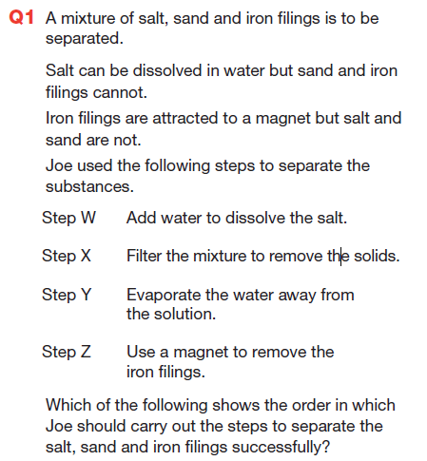
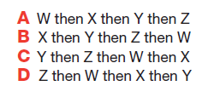
D. Step Z removes the iron filings;
Step W then dissolves the salt but not the sand in the water;
Step X, filtering, separates the sand from the solution and finally
Step Y evaporates the water leaving the salt.

Slide 40
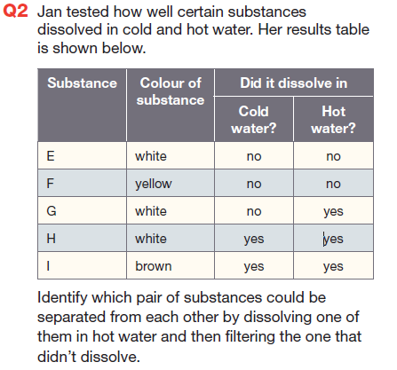
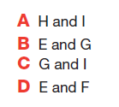
B. Substance E is not soluble in hot water;
substance G is soluble in hot water and will dissolve

Slide 41
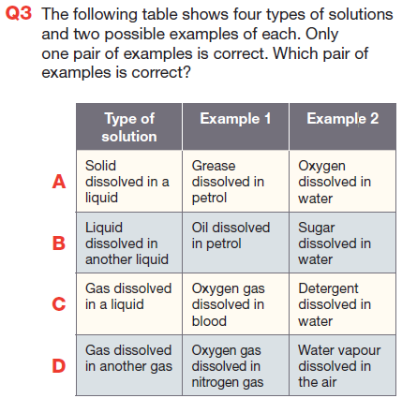
D. A is incorrect as oxygen is not a solid;
B is incorrect as sugar is not a liquid;
C is incorrect as detergent is not a gas.
D is correct as all substances listed are gases.

Slide 42
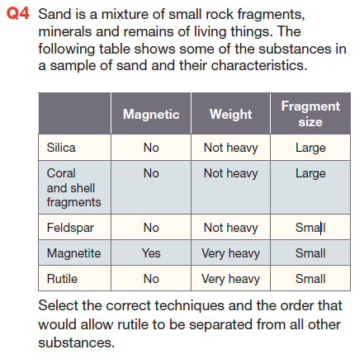
B. Gravity separation separates magnetite and rutile from the rest, then magnetic separation separates these two.

