Slide 1
Investigating Science
Review Questions
Answers

Slide 2
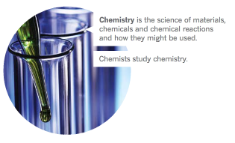
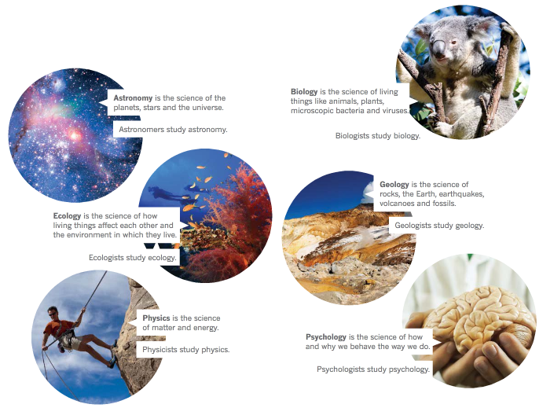
Module 1.1 unit review
Q3. List seven important
branches of science
Astronomy
Biology
Chemistry
Ecology
Geology
Physics
Psychology

Slide 3
Module 1.1 unit review
Q5 Specify the temperature that a Bunsen burner flame can reach.
A Bunsen burner flame can reach 1500°C.
Q6 List four dangers that you will meet in the laboratory.
Many possible dangers might be listed including:
extreme heat,
flames,
toxic or corrosive chemicals,
broken glass.

Slide 4
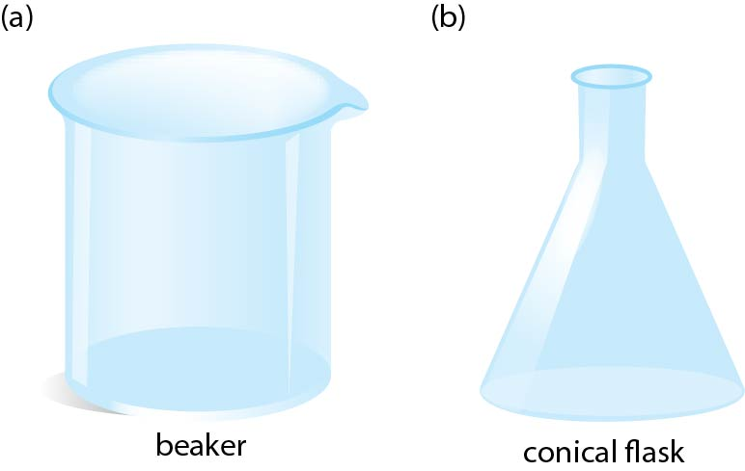
Module 1.1 unit review
Q7 Draw 2D diagrams showing the following
Equipment (a) beaker (b) conical flask
Q11 (a) The markings on beakers and conical flasks cannot be used to measure out volumes accurately. Explain why.
The markings on beakers and conical flasks are only rough measurements and therefore should not be used to accurately measure out volumes.
(b) Name the piece of equipment used to measure volumes accurately.
A measuring cylinder is used to accurately measure volumes

Slide 5
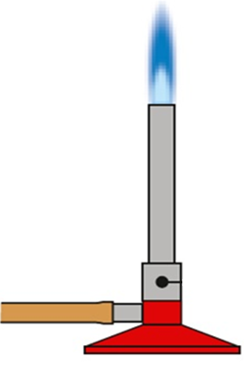
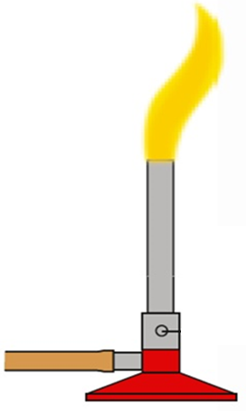
Module 1.1 unit review
Q12. A yellow flame will burn you if you are careless, but it is called the safety flame. Explain why.
A yellow flame is called the safety flame because it is relatively easy to see. This makes it less likely that you or anyone else would carelessly get too close to the flame.
Q14 Observations using the Bunsen Burner Flames
(a) dirty -- yellow
(b) noisy -- blue
(c) almost invisible -- blue
(d) extremely hot -- blue
(e) closed air hole -- yellow

Slide 6
Q20. Propose reasons why:
(a) You should light a match before you turn on the gas to the Bunsen burner
You should light a match before you turn on the Bunsen burner gas, to ensure there is no build up of gas, which could cause an explosion.
(b) Long hair should be tied back when you are using the Bunsen burner
Untied long hair can accidentally get in the flame of a Bunsen burner. This can be avoided by tying it back.
(c) Eating and drinking is banned in the laboratory
Toxic (poisonous) chemicals and acids are in the laboratory. Biological hazards can also be there because it is also where dissections are carried out. It is incredibly dangerous if any traces of these materials get into food
(d) You should turn a Bunsen burner to a yellow flame if you need to leave it.
If you leave a Bunsen burner, it needs to be seen. This is easier when it is left as a yellow flame.

Slide 7
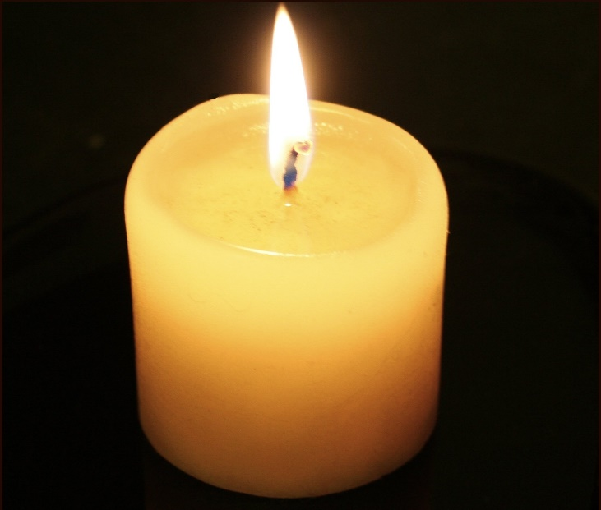
Module 1.2 unit review
Q4 List three observations you may see from each of the following:
(a) a candle -- its shape and colour, its texture, the length and diameter of the candle and wick, its smell, its state (solid)
(b) molten (melted) candle wax -- its colour, how fast it drips, its temperature, whether it is clear or not, its state (liquid)
(c) a candle flame -- its colour, height, brightness, the heat coming from it
(d) the smoke from a candle that has been blown out -- its colour, shape and patterns formed, how long it lasts

Slide 8
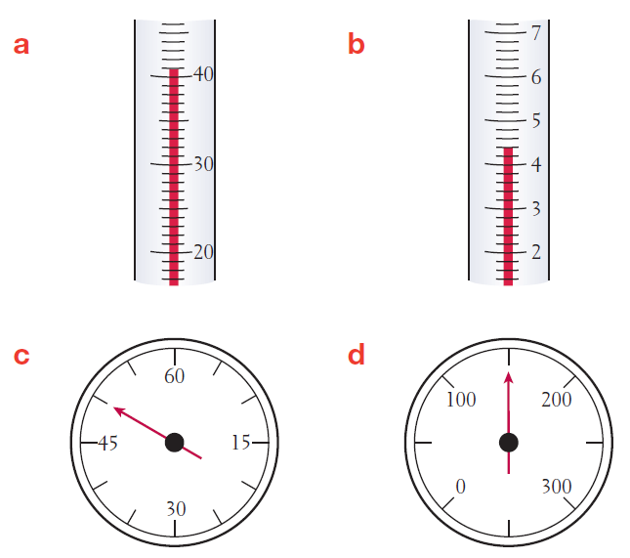
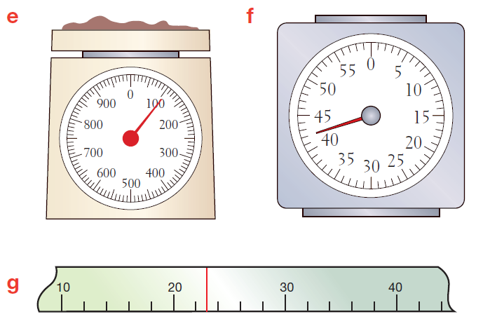
Module 1.2 unit review
Q5. State the measurements shown in each of the measuring devices
41
4.4
110
42
50
150
23

Slide 9
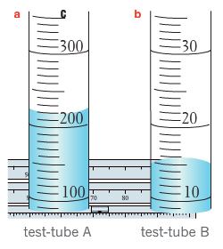
Module 1.2 unit review
Q7. State which of the abbreviations below are correct for these units:
(a) gram D = g (b) kilogram B = kg (c) millimetre B = mm (d) litre D = L (e) minutes A = min
Q8 What volumes are indicated in test tube A and B
A = 220mL B= 16mL
Q10. Explain what advantages quantitative observations have over qualitative observations.
Quantitative observations give more detail than qualitative observations. They are understood by everyone and are not open to individual interpretation.

Slide 10
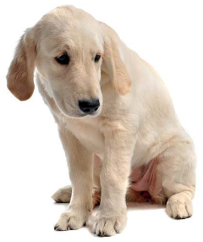
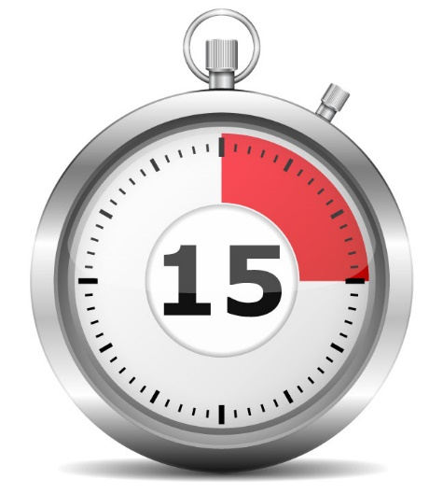
Module 1.2 unit review
Q13 Identify the best SI unit to measure the:
(a) mass of a mouse – grams (g)
(b) time it takes to sneeze – seconds (s)
(c) mass of a person – kilograms (kg)
(d) volume of a swimming pool – Litres (L)
(e) temperature of a sick dog – degrees Celsius (°C)
Q15. Classify the following observations as qualitative or quantitative.
(a) The night was dark - qualitative
(b) It took 15 minutes to walk to school - quantitative

Slide 11
Module 1.3 unit review
Q1 Define the following terms:
(a) continuous: where there is always a number between any two numbers you choose
(b) discrete: where observations can be grouped into categories such as colour
Q2 What term best describes the following:
(a) what you intend to do -- aim or purpose
(b) educated guess -- hypothesis
(c) the end -- conclusion

Slide 12
Module 1.3 unit review
Q6. Adrian ran an experiment in which he tested how much sugar would dissolve in a hot cup of tea.
Identify the best conclusion for his experiment.
A The experiment was fun.
B I learnt a lot from the experiment about sugar dissolving in hot tea.
C 3 teaspoons of sugar were able to be dissolved in a hot cup of tea.
D Tea tastes better when there is sugar dissolved in it.
Q7. Identify whether a column/bar, pie or line graph would best show the following results.
(a) The top speeds of different makes of cars → column/bar graph
(b) The temperature of a room throughout a winter’s day → line graph
(c) The types of animal with different numbers of legs → column/bar graph
(d) The percentages of your classmates who were born in Australia and overseas → pie chart
(e) Your height as you get older → line graph

Slide 13
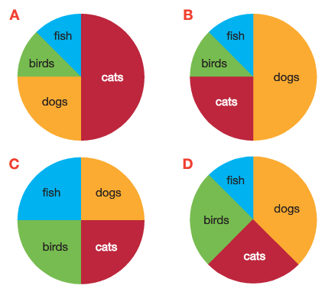
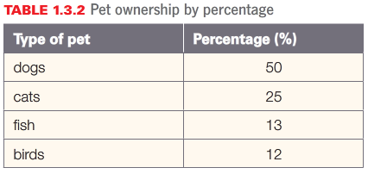
Module 1.3 unit review
Q8 Identify which if the following pie graphs
best represent the results in the below table

Slide 14
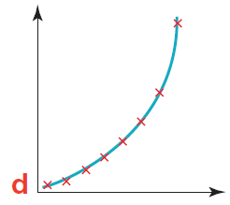
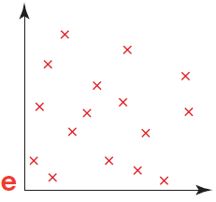
Module 1.3 unit review
Q9. Use the key below to identify the term that best describes the trend shown in each of the line graphs. A constant B increasing C decreasing D no trend shown
B = Increasing
C = Decreasing
A = Constant
B = Increasing
D = no trend

Slide 15
Module 1.3 unit review
Q10 Use examples to show the difference between discrete and continuous data
Discrete measurements fall into definite categories with no measurements possible between the categories
Eg: Comparing eye colour, hair colour, favourite sport
Continuous measurements are measured in numbers. Between the numbers are always sub-divisions allowing measurements to be taken between them.
Eg: Measuring heights, weights, temperatures, time

Slide 16
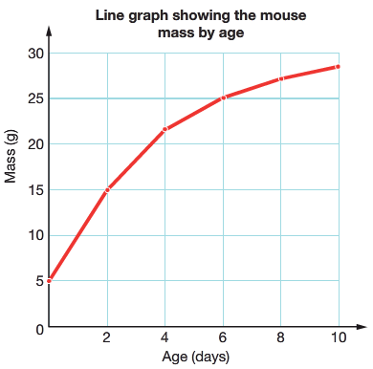
Module 1.3 unit review
Q11
(a) Describe what the term “line of best fit” means
A line of best fit is a line drawn through the centre of the points plotted on a graph.
(b) Explain why a line of best fir is used instead of joining up points on a graph like a dot to dot
Joining up a graph dot-to-dot assumes there are no errors in the measurements. Lines-of-best fit allow for some ‘give and take’ in the measurements.
(c) What is wrong with the graph on page 25?
The graph is plotted dot-to-dot.

Slide 17
Module 1.4 unit review
Q1 Define the following terms:
A variables: factors that may influence an experiment
B fair test: an experiment where only one factor or variable at a time is changed
Q2 What term best describes the following:
(a) a variable that is kept the same through an experiment -- controlled variable
(b) the variable that is changed during the experiment -- independent variable
(c) the variable that changes naturally because another variable is changed -- dependent variable

Slide 18
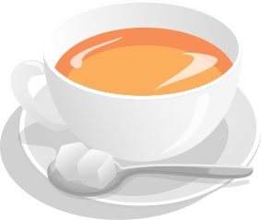
Module 1.4 unit review
Q5. List variables that are likely to affect the:
(a) amount of sugar that will dissolve in a cup of tea →
Temperature of water, size of cup, amount of stirring, size of sugar granules
(b) number of visitors to a swimming pool →
Temperature of the day, rain or no rain, day of the week, school holidays or not
(c) growth of a plant →
Type of plant, amount of sunlight, water and fertiliser
(d) time taken to cook a potato →
Size of potato, type and age of potato, temperature of the water, method of cooking
(e) number of times you go to the toilet in a day →
The amount you drink, your age, the temperature of the day

Slide 19
Module 1.4 unit review
Q6. Explain why only one variable should be changed in any single experiment.
Only one variable should be changed in any single experiment, so that you know what caused any change in the dependent variable.
Q12 Use the rules for writing a good conclusion to write an appropriate conclusion that meets these aims:
(a) To test if fishing line is stronger than string
In conclusion, fishing line is much stronger than string.
(b) To prove that water boils at 100°C
In conclusion, water boils at 100°C.
(c) To determine how much water a sponge can hold
In conclusion, the sponge tested held 35 mL of water.

Slide 20
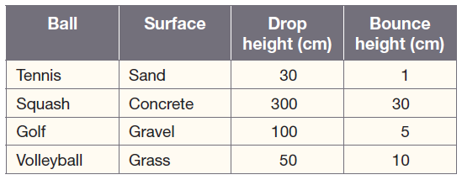
Q13. Bob ran an experiment on bouncing balls and recorded the following results.
On the basis of his results, he claimed that squash balls bounced better than tennis balls.
(a) State the dependent variable that Bob tested → the height a ball bounces
(b) Identify how many variables Bob changed during the experiment → three variables
(ball, surface and drop height)
(c) Assess whether the experiment was a fair test → The experiment was not a fair test because he had more than one independent variable
(d) Do you agree with Bob’s conclusion? Justify your answer
No conclusion can be made from this experiment since it is not a fair test

Slide 21
Chapter Review (page 37)
Q1 Define the following terms.
(a) meniscus → the curved top of liquid in a thin tube
(b) cross-section → a cutaway view, as if split vertically, horizontally or at an angle.
(c) hypothesis → educated guess of what might happen
(d) variable → a factor that might influence an experiment
Q2 Name the branch of science that studies:
(a) living things -- biology
(b) chemicals -- chemistry
(c) forces and energy -- physics
(d) behaviour -- psychology
(e) the Earth -- geology
(f) space -- astronomy
(g) the environment -- ecology

Slide 22
Chapter Review (page 37)
Q5 State two metric units commonly used for
(a) distance: mm, cm, m, km
(b) volume: mL, L, ML
(c) mass: mg, g, kg, t
Q6 Which abbreviation is correct for these units
(a) Degrees Celsius (°C) -- C
(b) Seconds (s) -- D

Slide 23
Q8. Classify the following observations as qualitative or quantitative.
(a) The cow went ‘moo’ → qualitative
(b) The car was travelling at 60 km/h → quantitative
(c) The Dockers won by 25 points → quantitative
(d) The Broncos won by a lot → qualitative
Q9. Describe the features of a safety flame.
A safety flame is:
yellow
quiet and dirty
produced when the air hole of the Bunsen burner is closed

Slide 24
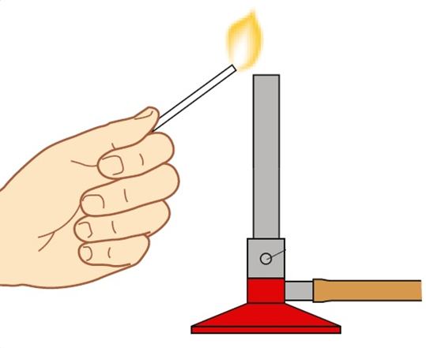
Q12 Identify the best SI unit to measure the:
(a) time to run the 100m sprint -- s
(b) mass of a car -- kg or t
(c) volume of water in a sink -- L
Q13 Identify the type of graph from the clues below:
(a) it shows percentages -- Pie graph
(b) it has two sets of measurements -- Line graph
(c) it has discrete groups along its bottom, horizontal axis -- Column graph
(d) it has discrete groups along its vertical axis -- Bar graph
Q15. Propose reasons why the Bunsen burner gas must be turned on after the match is lit.
If the tap is turned on first, the gas is being pumped into the room.
Lighting the match can then cause it to explode.

Slide 25
Thinking scientifically (page 39)
The Three Bears returned home and found someone had been eating their porridge.
Being scientific bears, they were interested in how fast different-sized bowls cooled.
They filled them with hot porridge and measured the temperature every minute.
Their results are shown in the table.

Slide 26
Q1 Identify which bowl cooled the fastest.
A Papa Bear’s
B Mama Bear’s
C Baby Bear’s → Because after 5 minutes, Baby Bears bowl had the lowest temperature
D Not enough information to decide

Slide 27
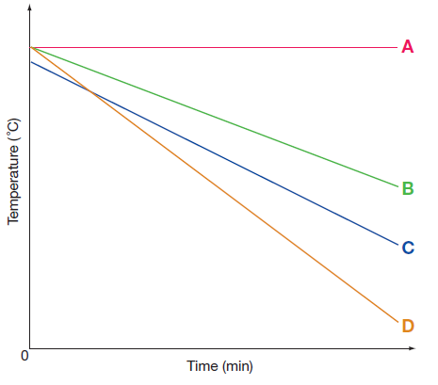
Mama Bear then sketched line graphs to show
what was happening. These are shown below:
Q2 Identify which graph most likely represents:
(a) Papa Bear’s bowl → B
(b) Mama Bear’s bowl → C
(c) Baby Bear’s bowl → D
Q3. Identify which of the following variables are unlikely to have much effect on the cooling of the porridge.
A size of bowl
B amount of porridge
C amount of sugar in porridge
D starting temperature of porridge

Slide 28
Q4 Baby Bear misread his thermometer once.
Identify which of his readings is probably wrong.
A 50°C
B 48°C
C 30°C
D 20°C
Q5 Papa Bear forgot to read his thermometer once.
Identify the most likely missing temperature.
A 31°C
B 53°C
C 50°C
D 18°C

Slide 29
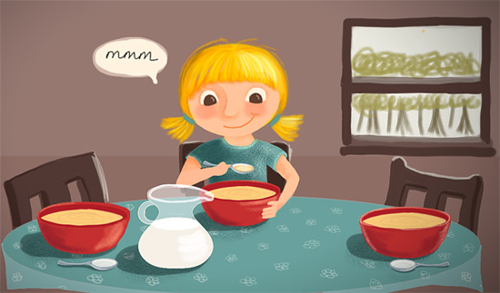
Q6 Mama Bear also forgot to read her thermometer.
Identify the most likely missing temperature.
A 30°C
B 24°C
C 20°C
D 18°C

